Slide 1
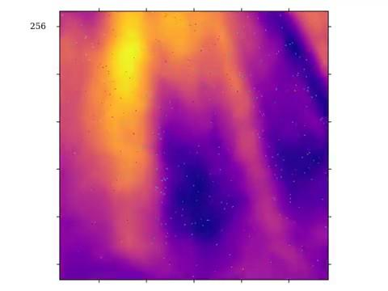
Ionospheric analyses with MWA EoR
Christopher Jordan on behalf of the MWA EoR team and John Morgan

Slide 2
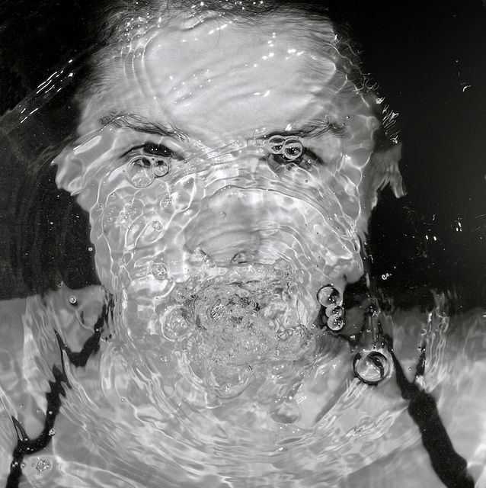
The ionosphere
Unpredictable refractive layer of atmosphere
lambda² dependence
Bigger effects at lower frequencies!
Must be considered for all sciences
Avoidance or mitigation
https://i.pinimg.com/736x/b5/41/18/b54118c04c551e9c8818bb2df0ba6bb4.jpg

Slide 3
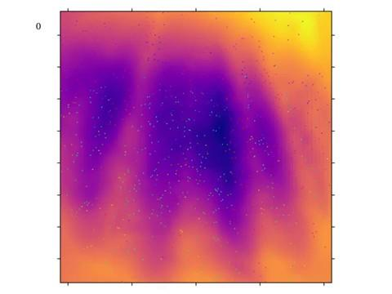

Slide 4
Goals from this research
Can we characterise ionospheric activity?
How does the ionosphere affect our data?
Can we remove its effect?
Can we predict poor observing conditions?

Slide 5
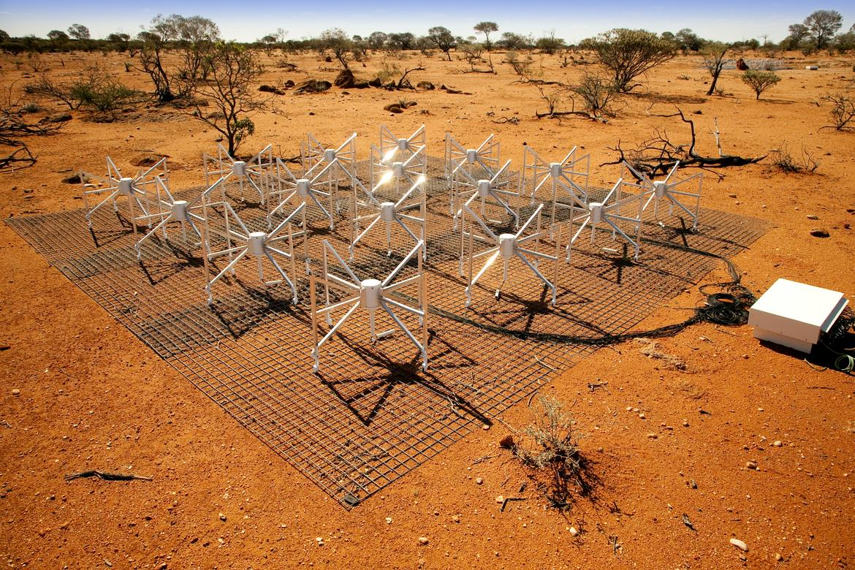
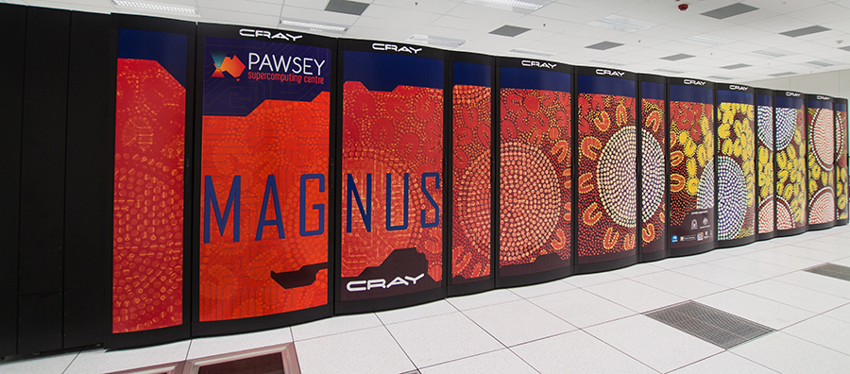
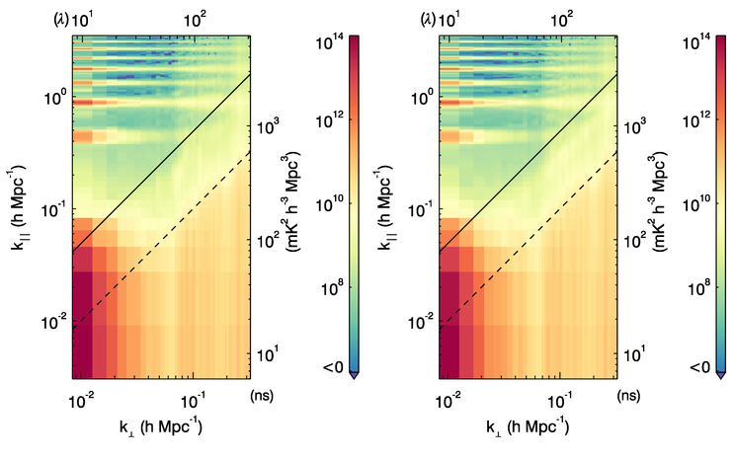
MWA EoR processing in a nutshell
Real-Time System (RTS)
CHIPS
https://skatelescope.org/wp-content/uploads/2013/10/MG_55471.screen.jpg
https://www.pawsey.org.au/wp-content/uploads/2014/11/magnus900.png

Slide 6
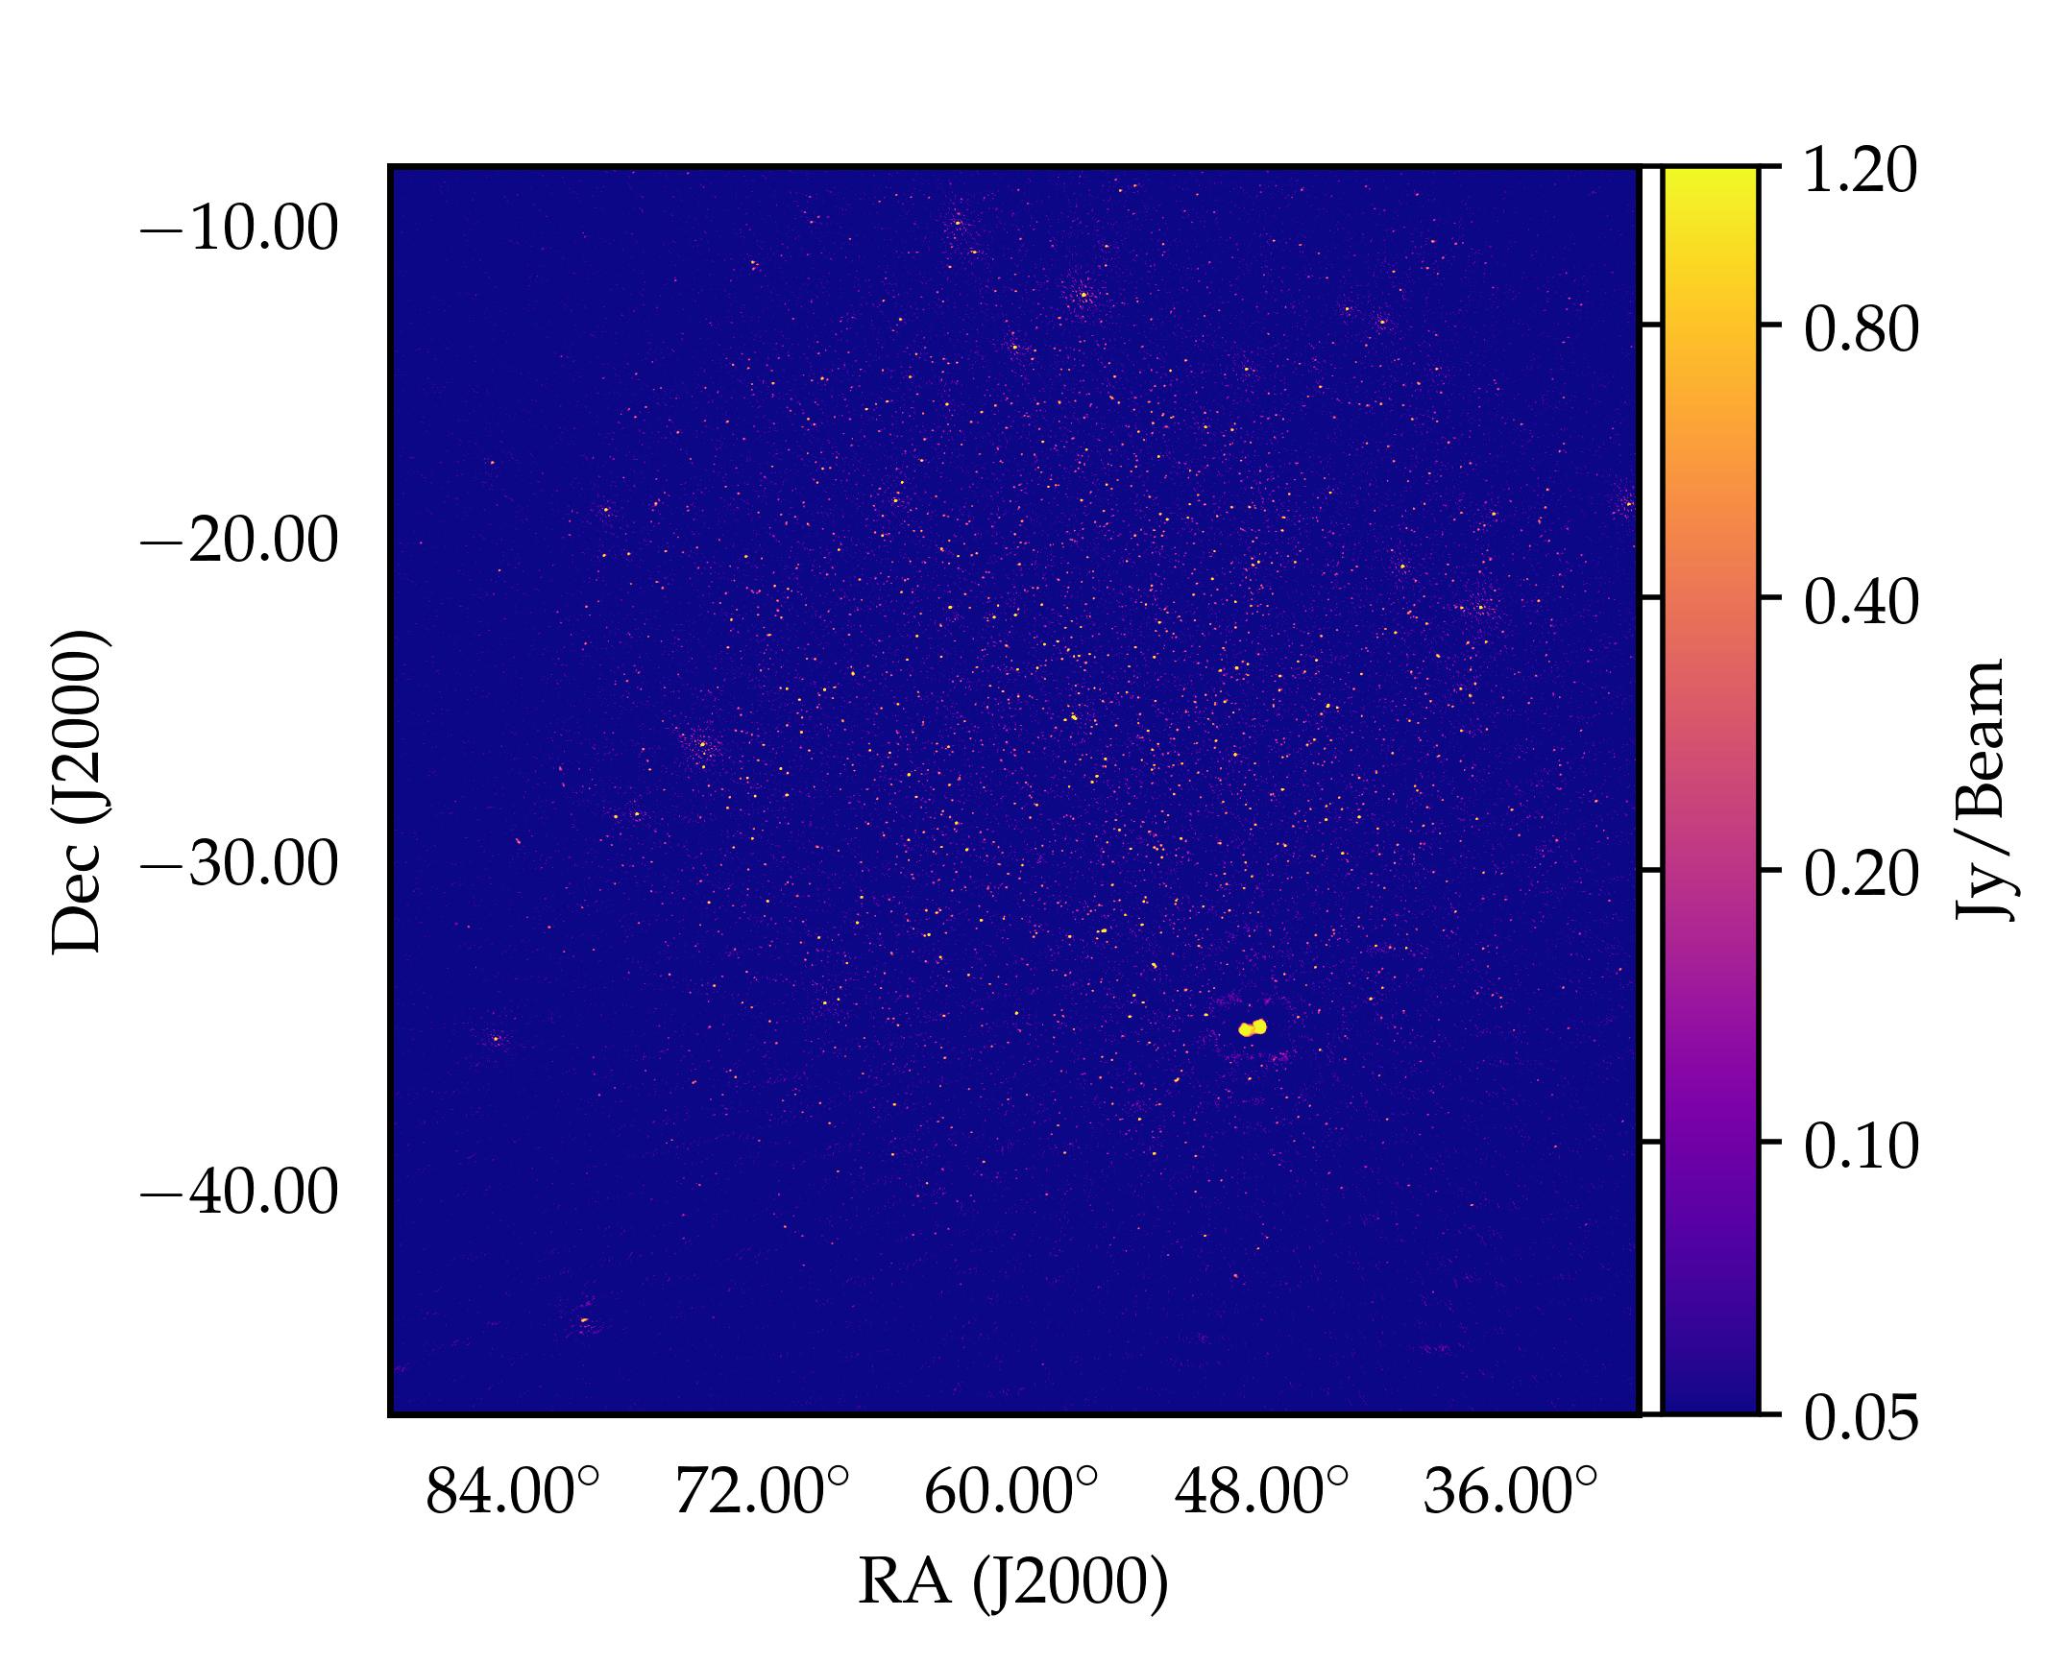
MWA EoR processing in a nutshell

Slide 7
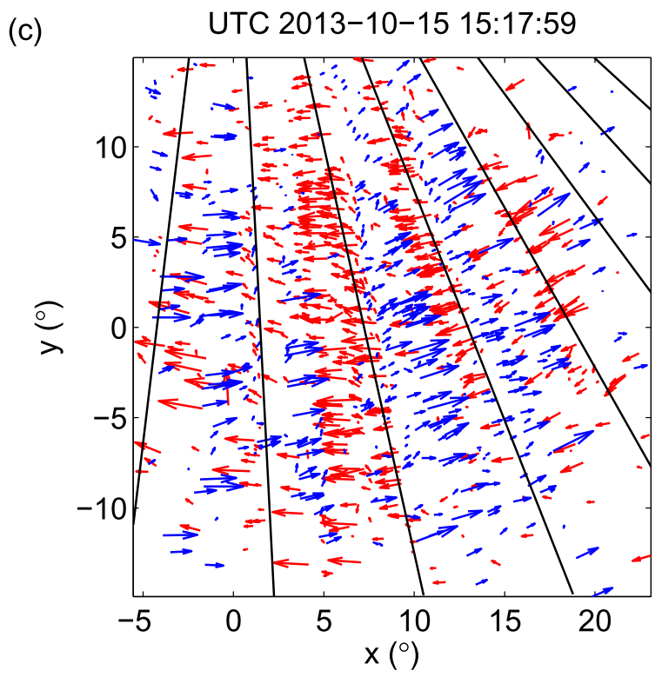
MWA EoR processing in a nutshell
Loi+ 2015

Slide 8
MWA EoR processing in a nutshell
“The Harker-O’Leary method”
(Harker M., O’Leary P., 2015)
https://gitlab.com/chjordan/pyGrad2Surf

Slide 9
MWA EoR processing in a nutshell
Loi+ 2015
https://gitlab.com/chjordan/cthulhu

Slide 10
MWA EoR processing in a nutshell
I’m surprised. It’s really simple to use. It’s working on my laptop without any error.
-- Shintaro Yoshiura
Loi+ 2015
https://gitlab.com/chjordan/cthulhu

Slide 11
MWA EoR processing in a nutshell
927x
Loi+ 2015
https://gitlab.com/chjordan/cthulhu

Slide 12
Characterisation of the ionosphere above the Murchison Radio Observatory using the Murchison Widefield Array
Jordan+ 2017
https://arxiv.org/abs/1707.04978

Slide 13
Key results from Jordan+ 2017
Four ionospheric “types” identified:
“Quiet”
“Large-scale”
“Anisotropic”
“Stormy”
74%, 15%, 2.3%, 8.4%

Slide 14
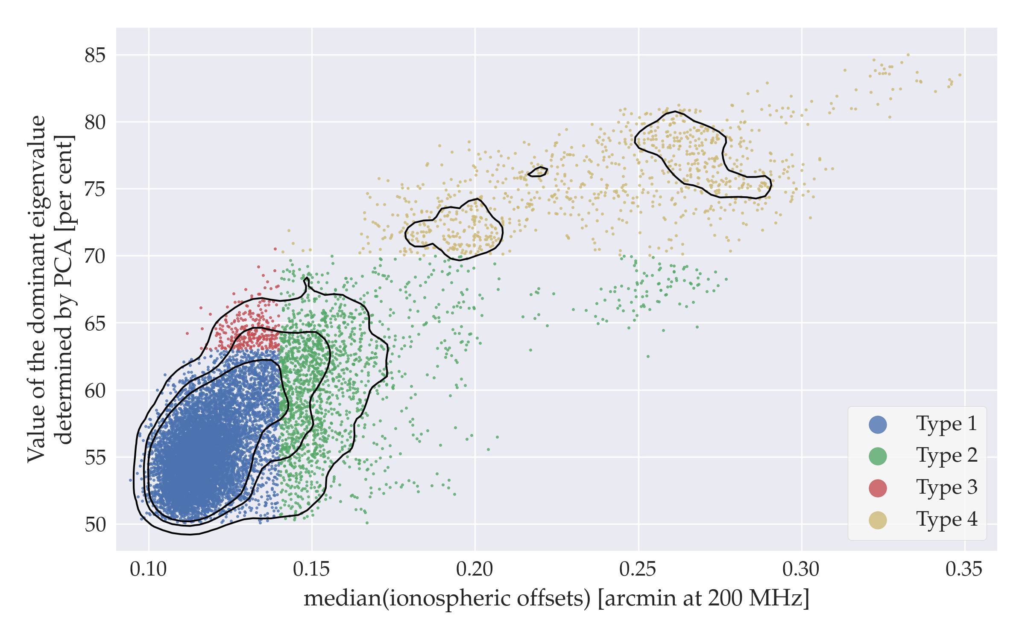
Key results from Jordan+ 2017
74%, 15%, 2.3%, 8.4%

Slide 15
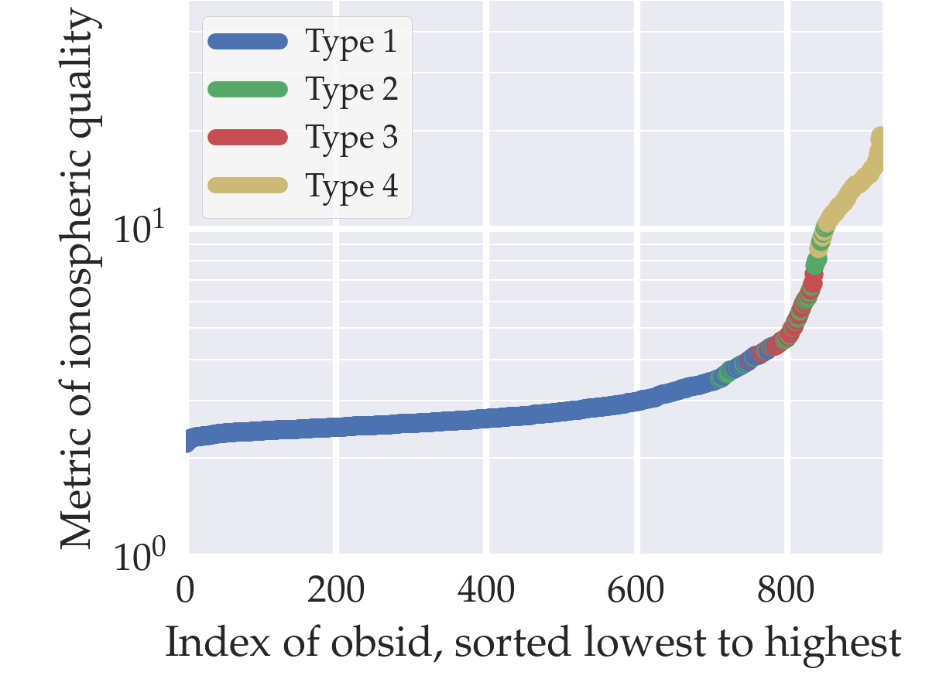
Key results from Jordan+ 2017

Slide 16
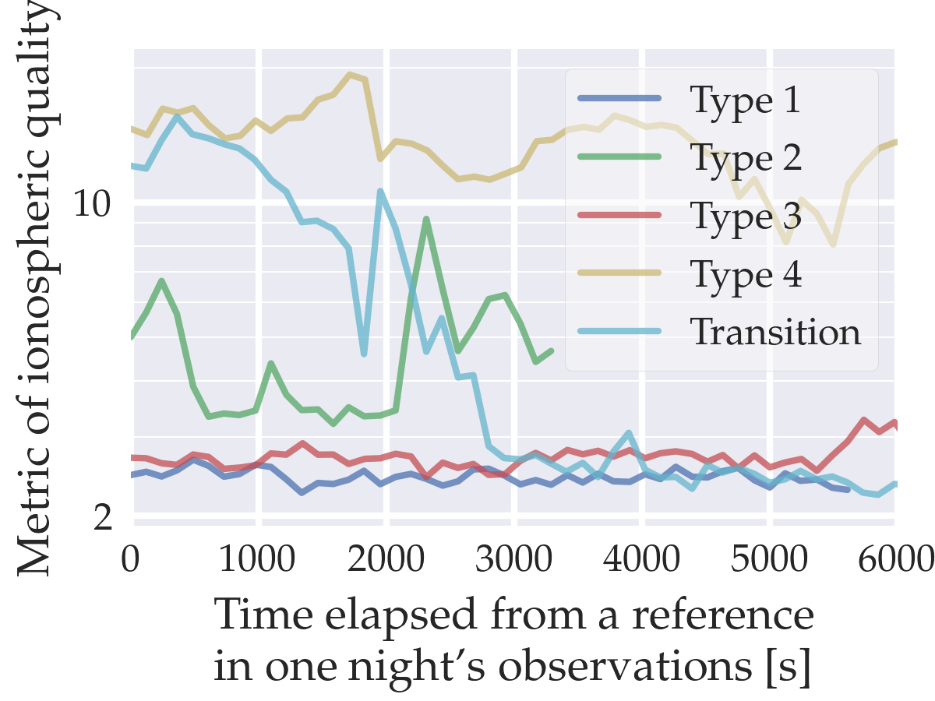
Key results from Jordan+ 2017

Slide 17
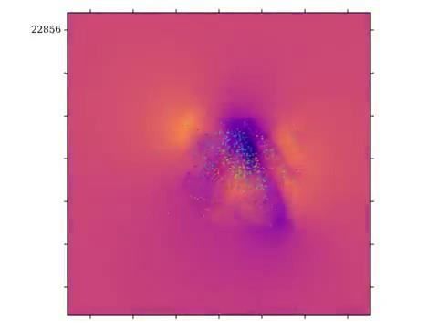
“The fighter jet”
“The jilted lover”

Slide 18
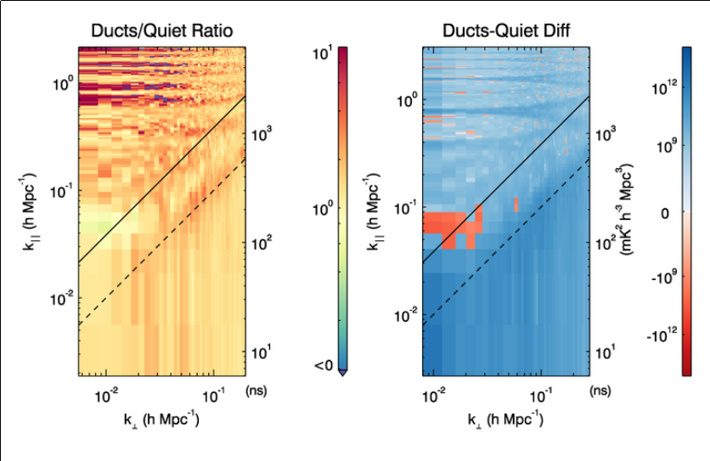
Trott+ 2018: “Impact of ionospheric activity on EoR Power Spectrum with the MWA”

Slide 19
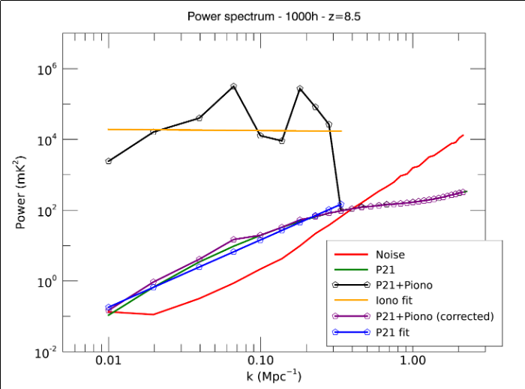
Trott+ 2018: “Impact of ionospheric activity on EoR Power Spectrum with the MWA”

Slide 20
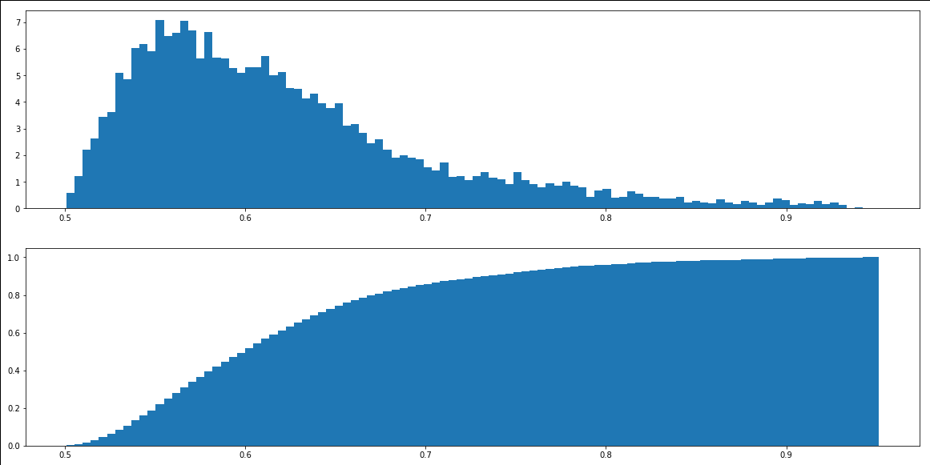
On-going analyses
10,526 obs.
PCA statistics

Slide 21
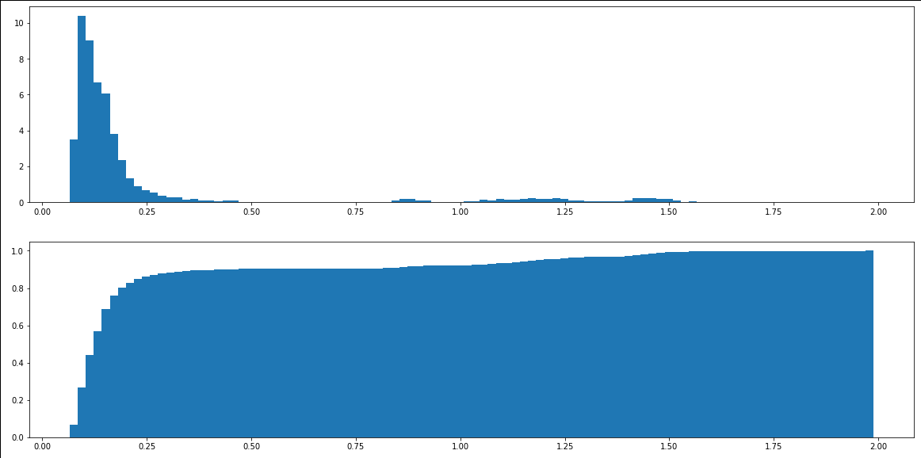
On-going analyses
10,526 obs.
Refractive shift statistics

Slide 22
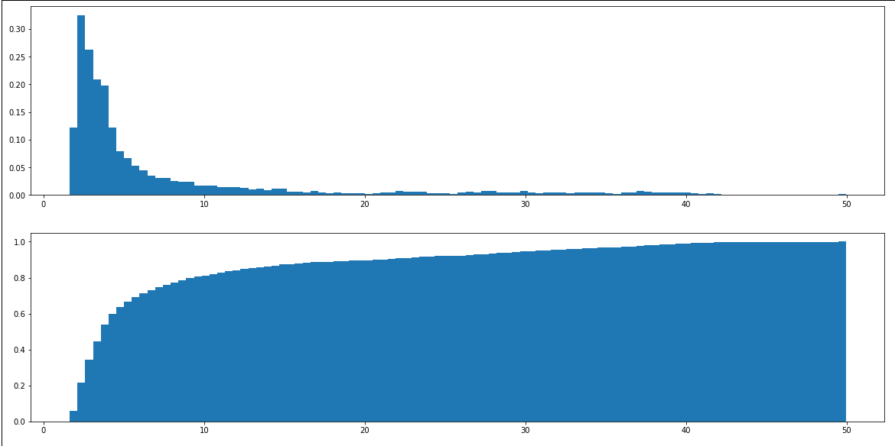
On-going analyses
10,526 obs.
Overall QA statistics
Derived from refractive shift and PCA

Slide 23
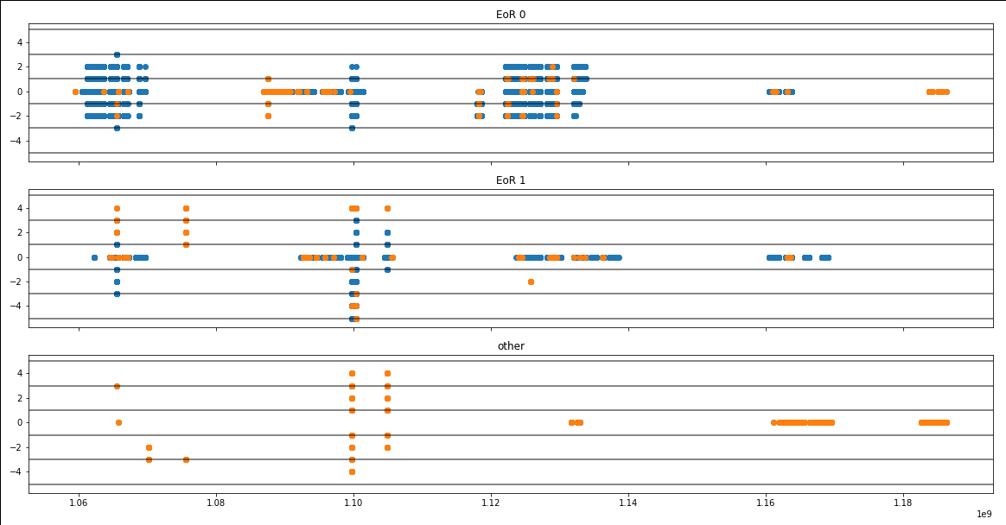
On-going analyses

Slide 24
On-going analyses
On the horizon:
“A census of ionospheric activity with MWA EoR”

Slide 25
The future...
Add extra “dimensions” to the quality-assurance (QA) database
Cotter occupancy
Ambient temperature
etc.
https://github.com/MWATelescope/mwa_qa
Identify a new “platinum set”
RTS many new observations!

Slide 26
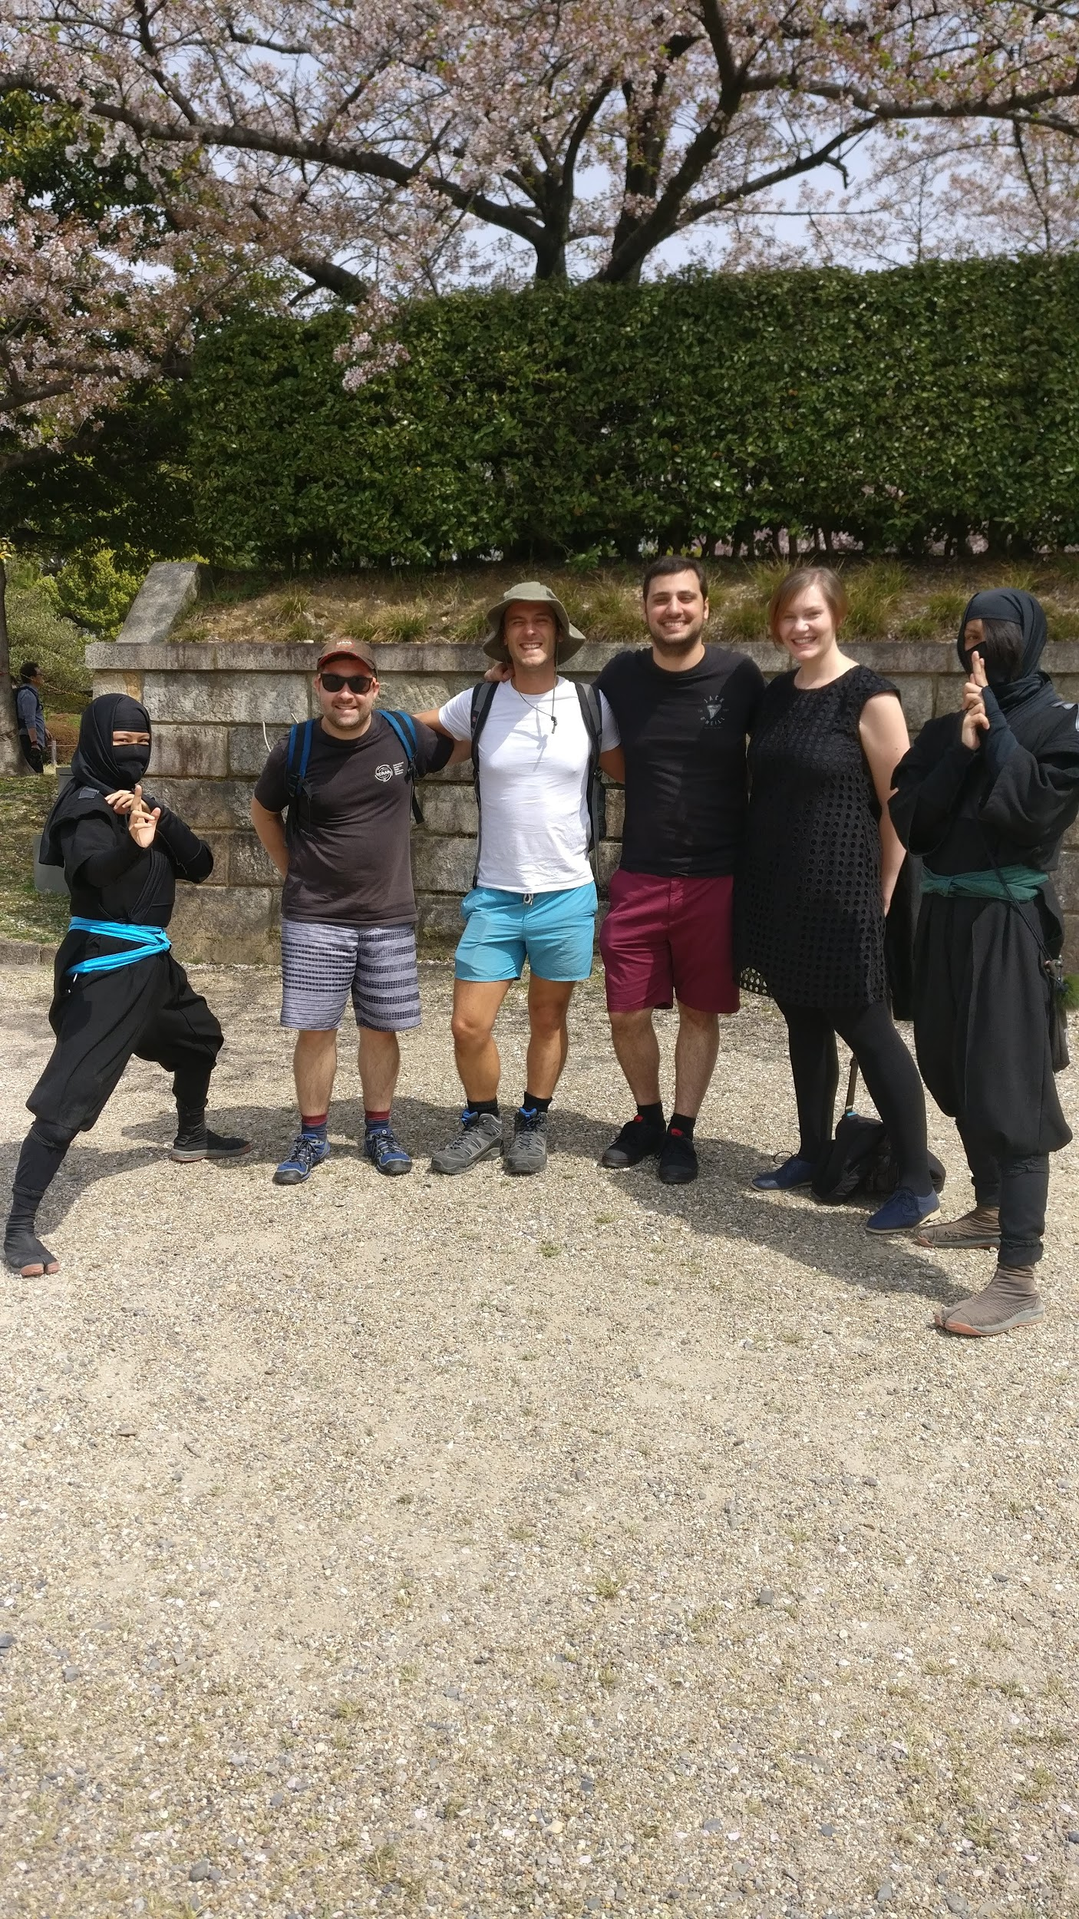
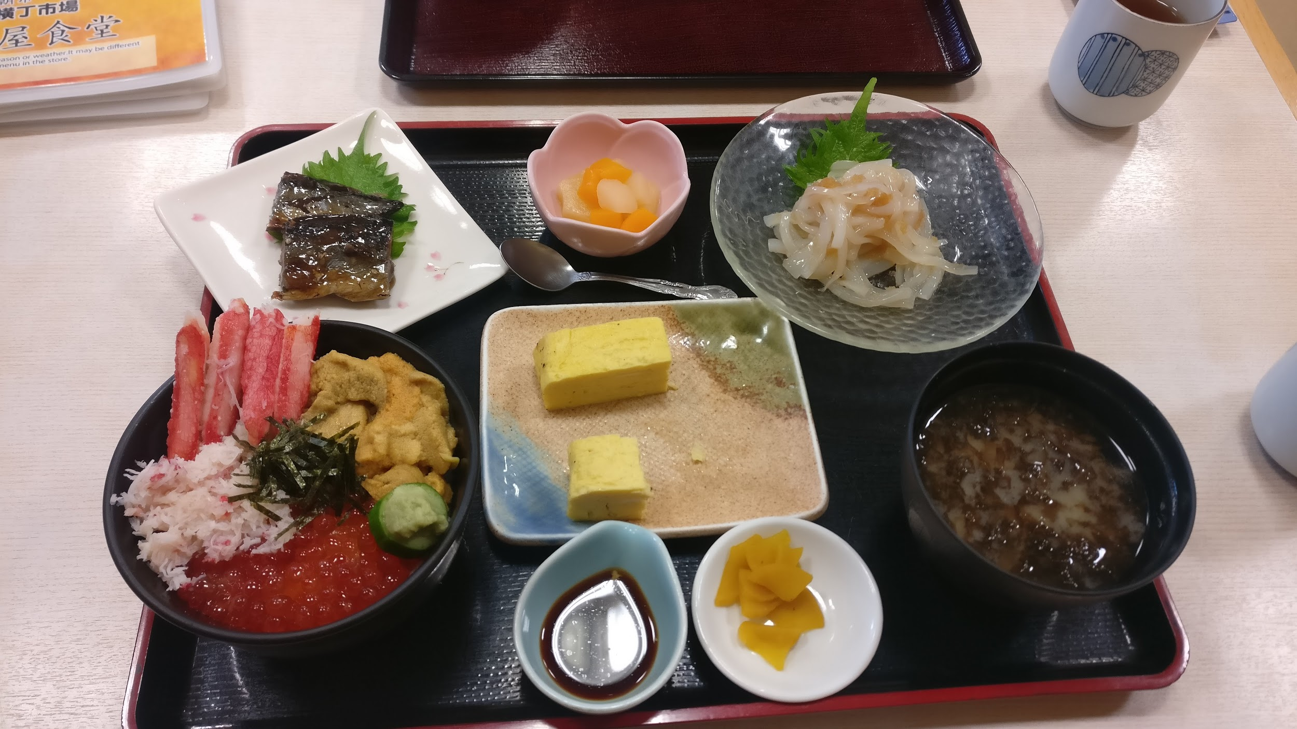
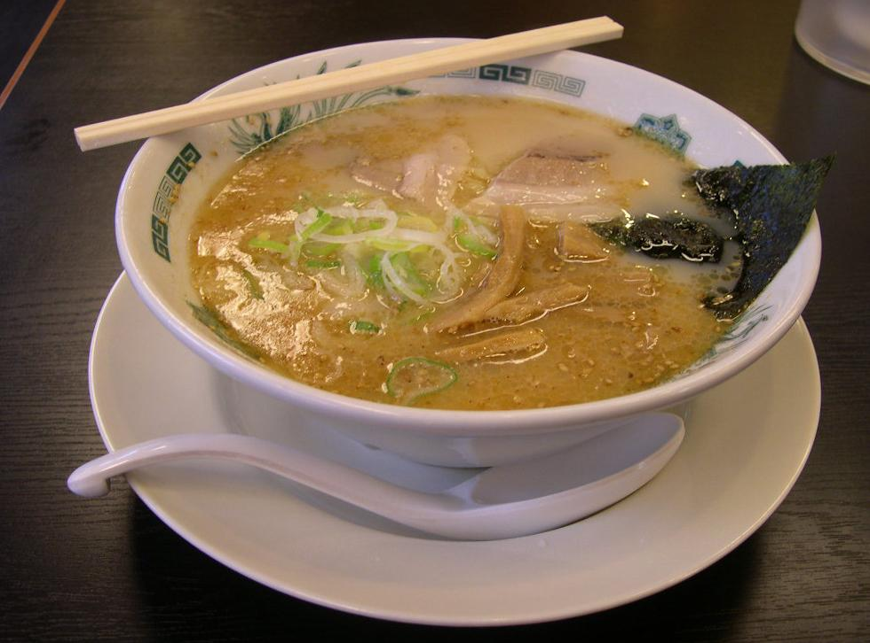
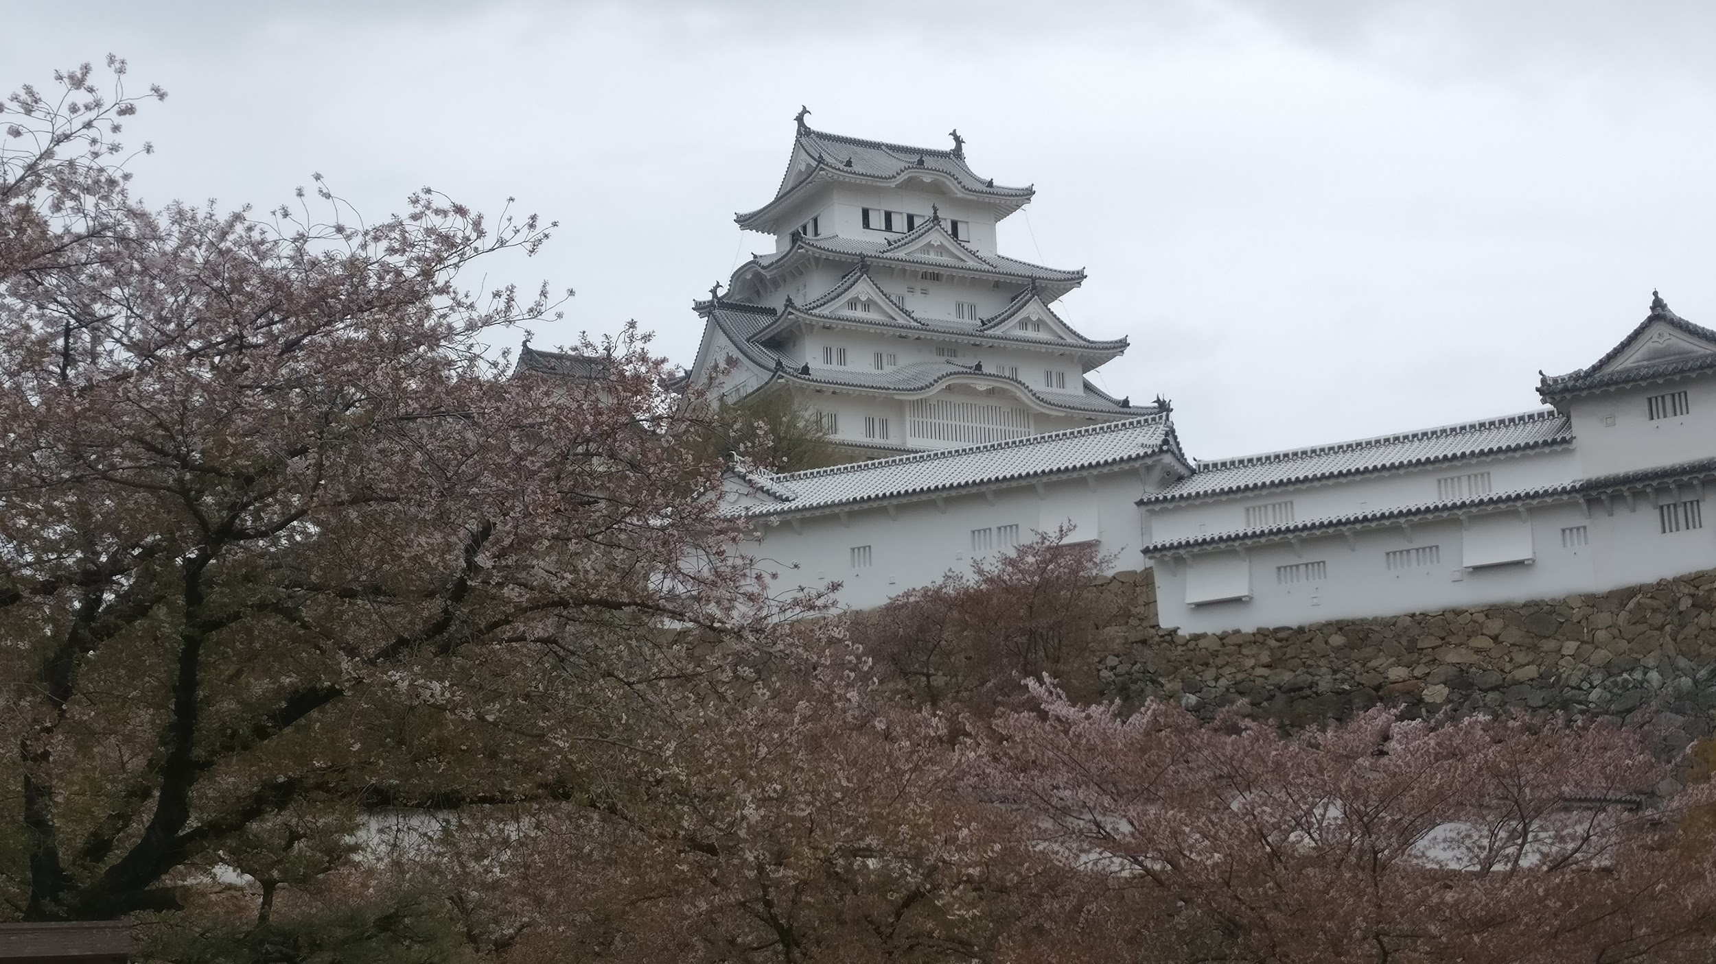
ありがとうございます

