Slide 1

Properties of Pulsars at Low Radio Frequencies
6th Dec 2018, SALF V, Nagoya
Mengyao Xue

Slide 2
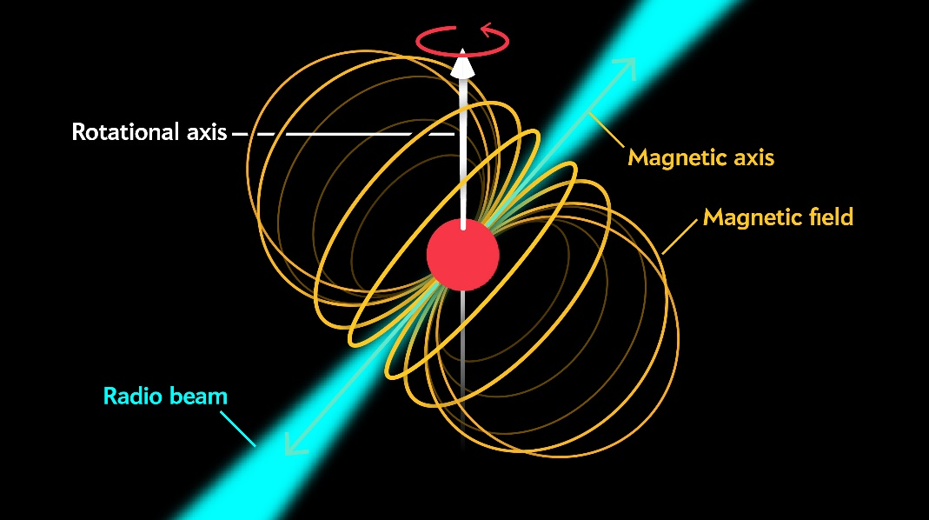

Pulsars
    Neutron stars
    Rapidly rotating
    (~ 1 ms to 10 s)
    Radius: ~ 10 km
    Mass: ~ 1.2 to 2.3 M☉
    Pulse:
      Light house effect
Credit: Jen Christiansen
Notes:
Pulsars are rapidly rotating, highly magnetised neutron stars. They are very compact objects with a radius arouond10 kilometers and a mass around 1.4 solar mass. The overall magnetic field structure of pulsars is thought to be dipolar, and the magnetic axis is inclined to the rotation axis, producing a ‘lighthouse’ effect. A pulse can be observed when the emission beam sweeps past the line of sight of us.

Slide 3
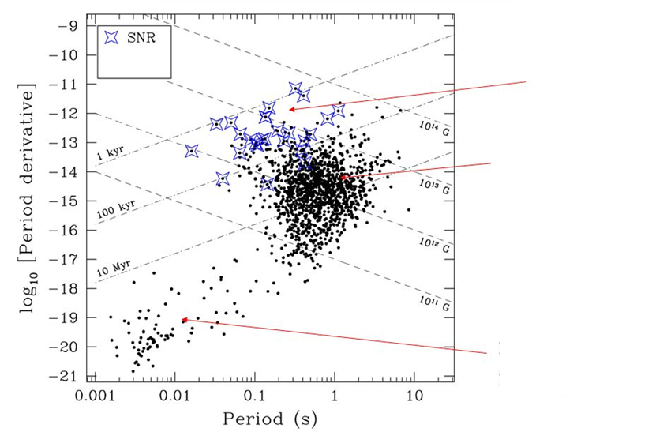
Life circle and energy budget for pulsars
Young radio pulsars
Main radio pulsar population
Millisecond pulsars
Credit: Vicky Kaspi
Notes:
Comes from it’s rotation kinetic energy

Slide 4
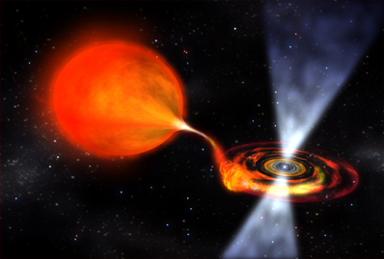

Millisecond pulsar (recycled pulsar)
High precision timing
Can be used for gravitational wave detection
(See poster by Shinnosuke Hisano)

Slide 5
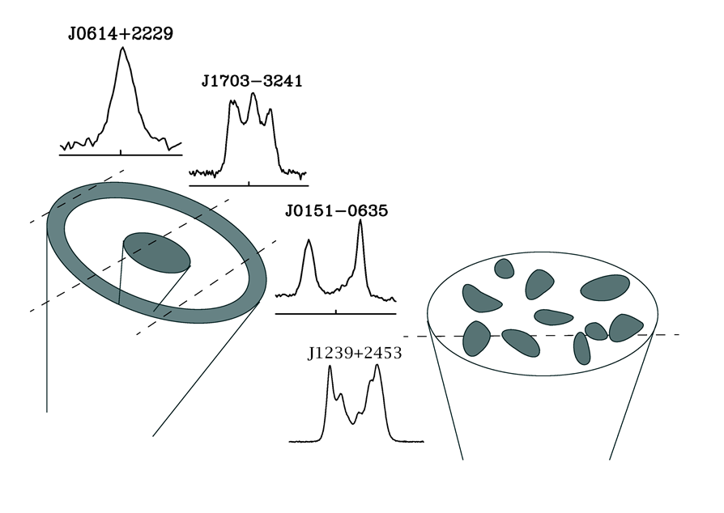
Pulse profiles & Emission beam geometry
Core & cone model: Oster & Sieber (1976), Rankin (1993), Gil et al. (1993)
Patchy model: Lyne & Manchester (1988)

Slide 6
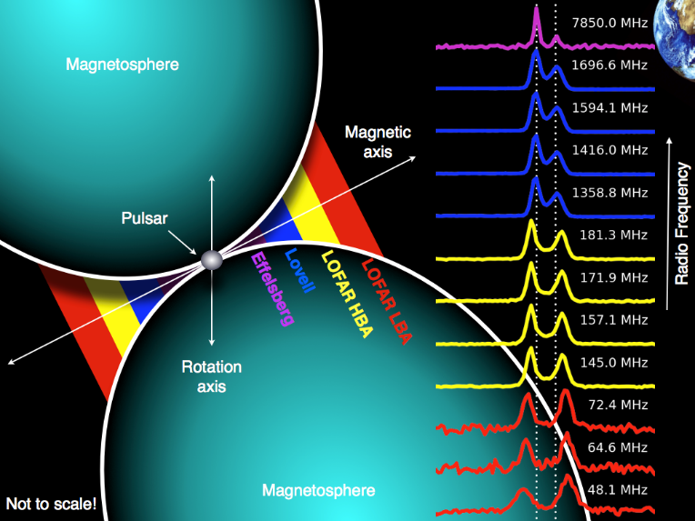
Pulse Profile evolution with frequencies
Credit: Tom hassall

Slide 7
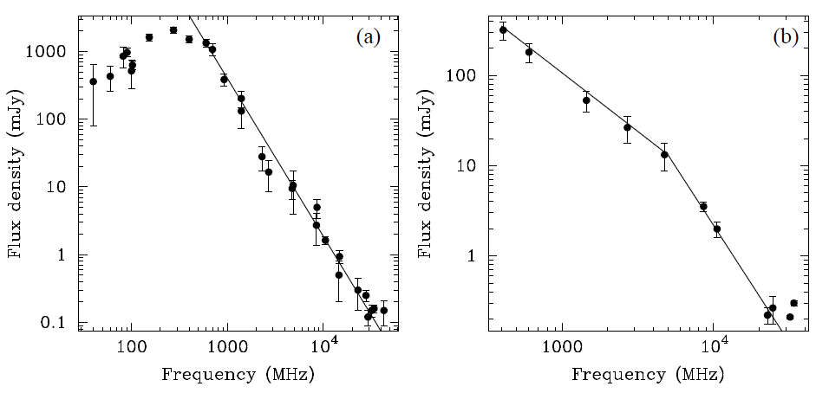
Spectral index
Power law
The range of observed spectral indices is broad: -4 < α < 0
Mean value: −1.6±0.3 −1.8±0.2 -1.4±0.9
(Lorimer et al. 1995)
(Maron et al. 2000)
(Bates et al. 2013)
Turnover
Flattening
PSR B0329+54
PSR B1929+10
Handbook of Pulsar Astronomy

Slide 8
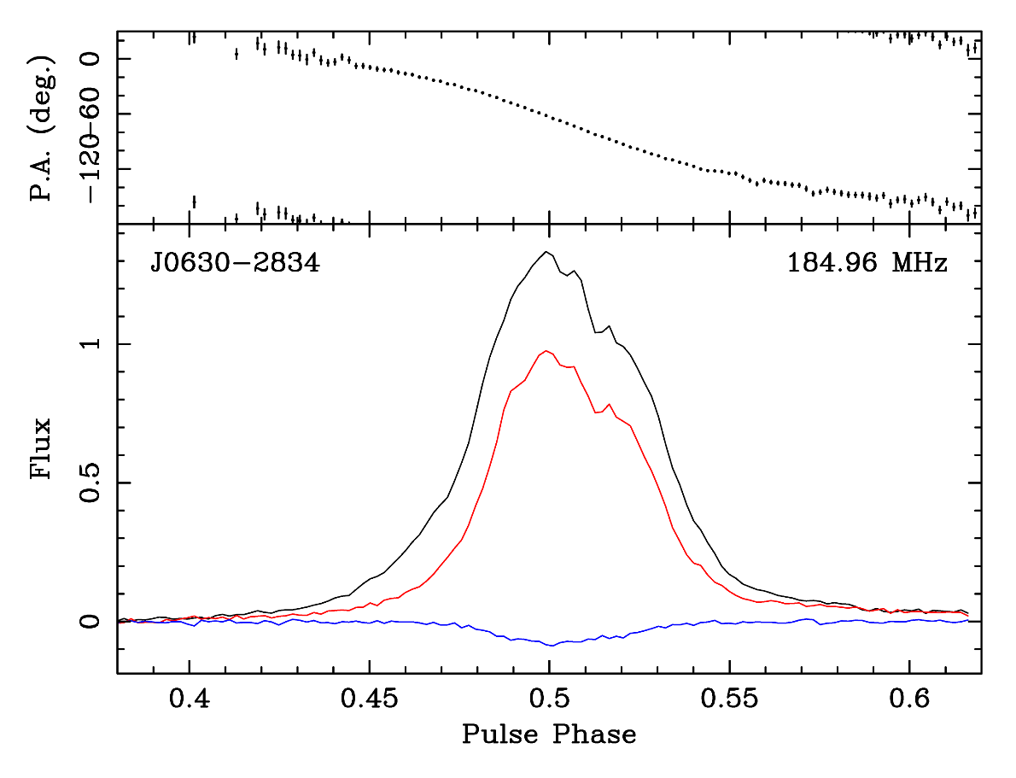
Polarisation properties
    Highly magnetised
      (~10⁸ - 10¹⁴ G)
    Highly polarised radio emission
    Linear:
      Average ~20%, highest ~100%
      Tends to ↓ with frequency ↑
    Circular :
      Average ~10%
Total intensity
(I profile)
Linear polarisation (L profile)
J0630-2834
MWA
Circular polarisation (V profile)

Slide 9

Propagation effects due to ISM
Inhomogeneous ISM
-> Scattering screen
Magnetic field
-> Faraday rotation
$$\vec{B}$$
Homogeneous ionised ISM
-> Dispersion
All these effects are frequency dependent!

Slide 10
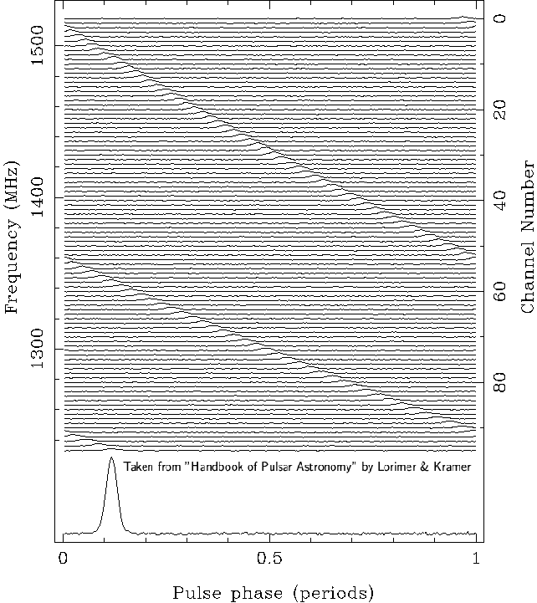
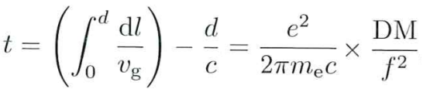
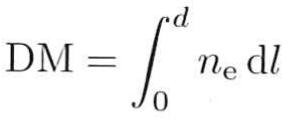
Propagation effects due to ISM
Dispersion
Different group velocity for different frequency wave in the ionised ISM
Low frequency signals will arrive later than higher ones
Dispersion Measure (DM)

Slide 11
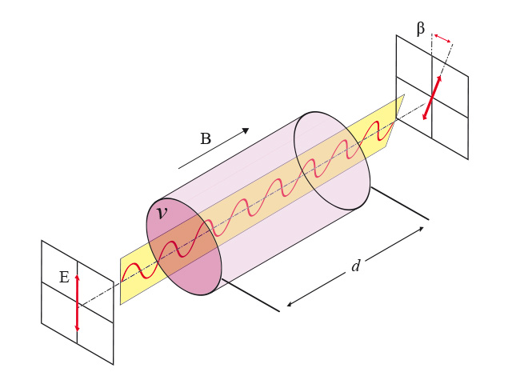

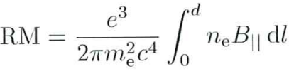
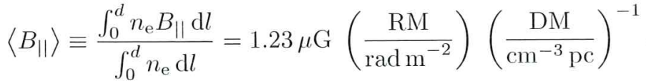
Propagation effects due to ISM
Faraday Rotation Measurements (RM)
Credit: wikipedia.org
Can be used to Probe the galactic magnetic field

Slide 12
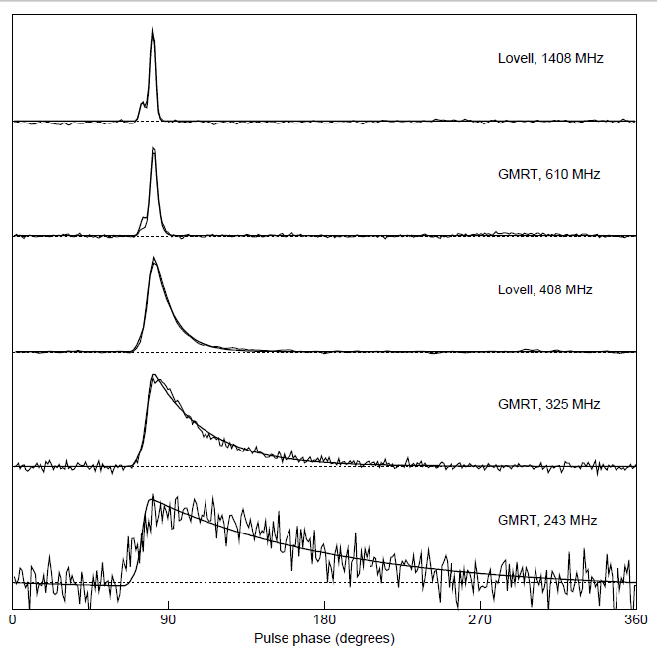
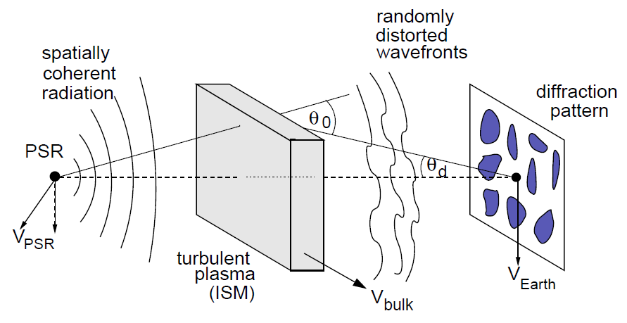
Propagation effects due to ISM
Scattering
A thin-screen model

Slide 13
Why Pulsars at < 300MHz
Surveys
Huge field-of-view
Higher flux density
Emission mechanism
Profile evolution
Polarimetry
Spectral indices (flattening, turnover, etc.)
Emission phenomena (nulling, sub-pulse drifting, etc.)
Interstellar medium
Precise dispersion measure
Precise rotation measure
Scattering

Slide 14
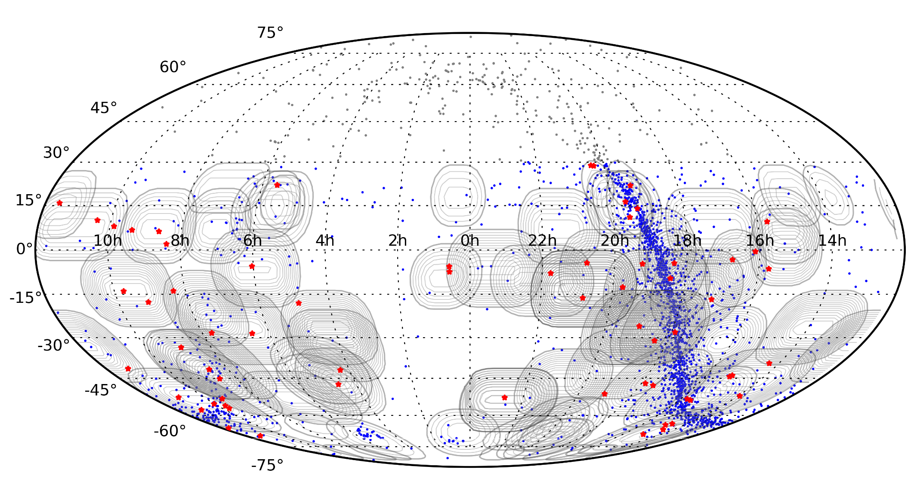
Initial pulsar census at 185 MHz
65 known pulsars in 47 hours of observations, 6 millisecond pulsars (MSPs)
(50 in the paper & 15 from later on processing)
Known (catalogued) pulsars outside the MWA's Dec limit
Known (catalogued) pulsars visible to the MWA
MWA-VCS pulsars
Xue et al. (2017)
Notes:
Subsequent?

Slide 15
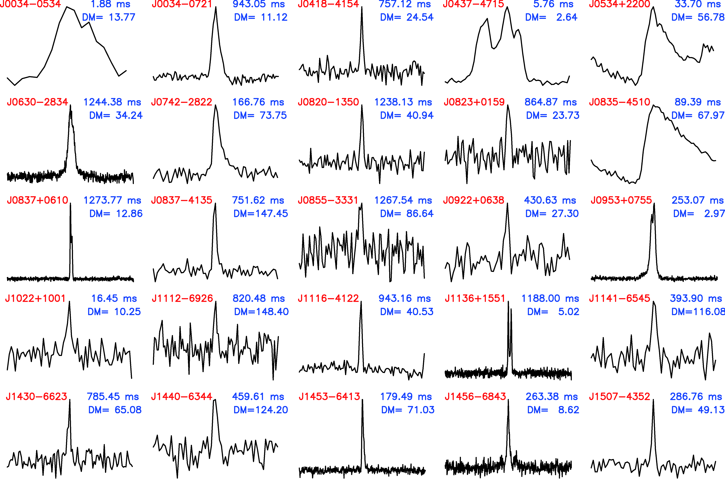
Pulse profiles for MWA-VCS pulsars
@185 MHz
MSP
MSP
DM range:
2.64 to 180
cm⁻³ pc
Binary
Period range:
1.74 to 1960
ms
MSP
Binary
Xue et al. (2017)
Notes:
some of profiles are noisy but will be better when we reprocessing them with coherent beamform pipeline.

Slide 16
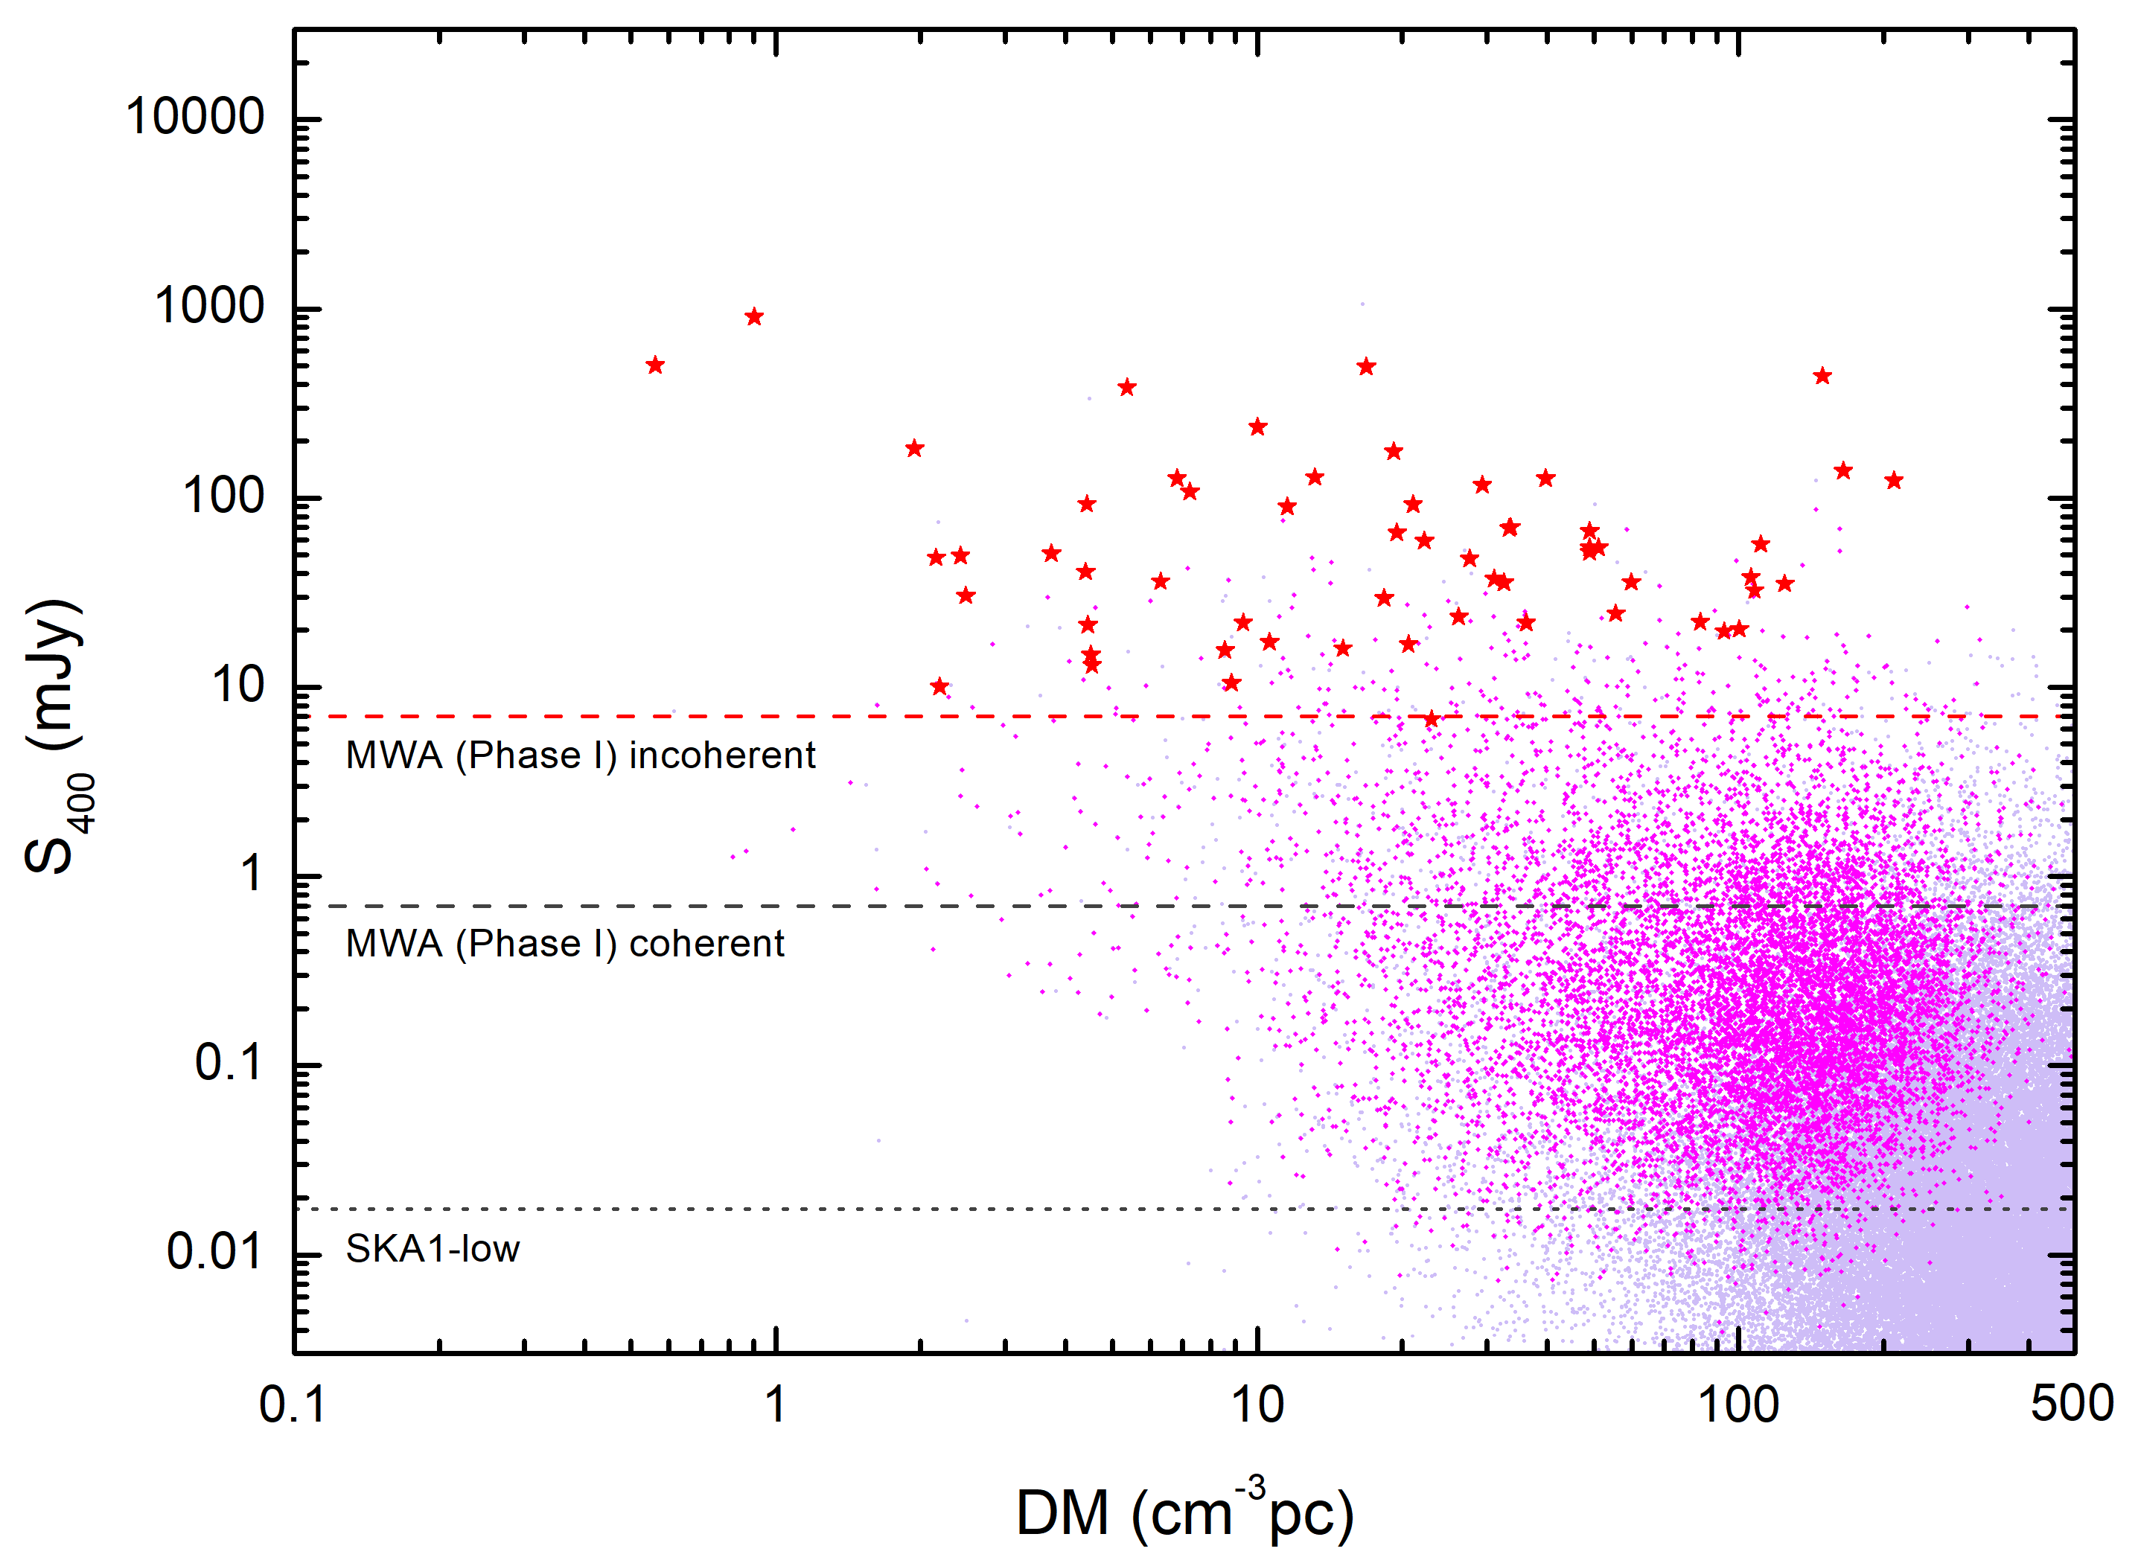
SKA1-low pulsar detection prospect
PSRPOP total population
Detectable pulsars using SKA1-low
Detectable pulsars using MWA incoherent
SKA1-low: ~ 9400 pulsars
Notes:
Based on our detection result, we also use psrpoppy to generate simulated pulsar population and do SKA1-low simulate survey on it. We predict SKA1-low could detect around 9400 pulsars.
This plot shows the total population and detectable pulsar for SKA1-low from the simulation.

Slide 17
Searching for new pulsars
with low-frequency
instruments
See also talks by
Hiroki KUMAMOTO
Naoyuki YONEMARU
Zhongli ZHANG

Slide 18
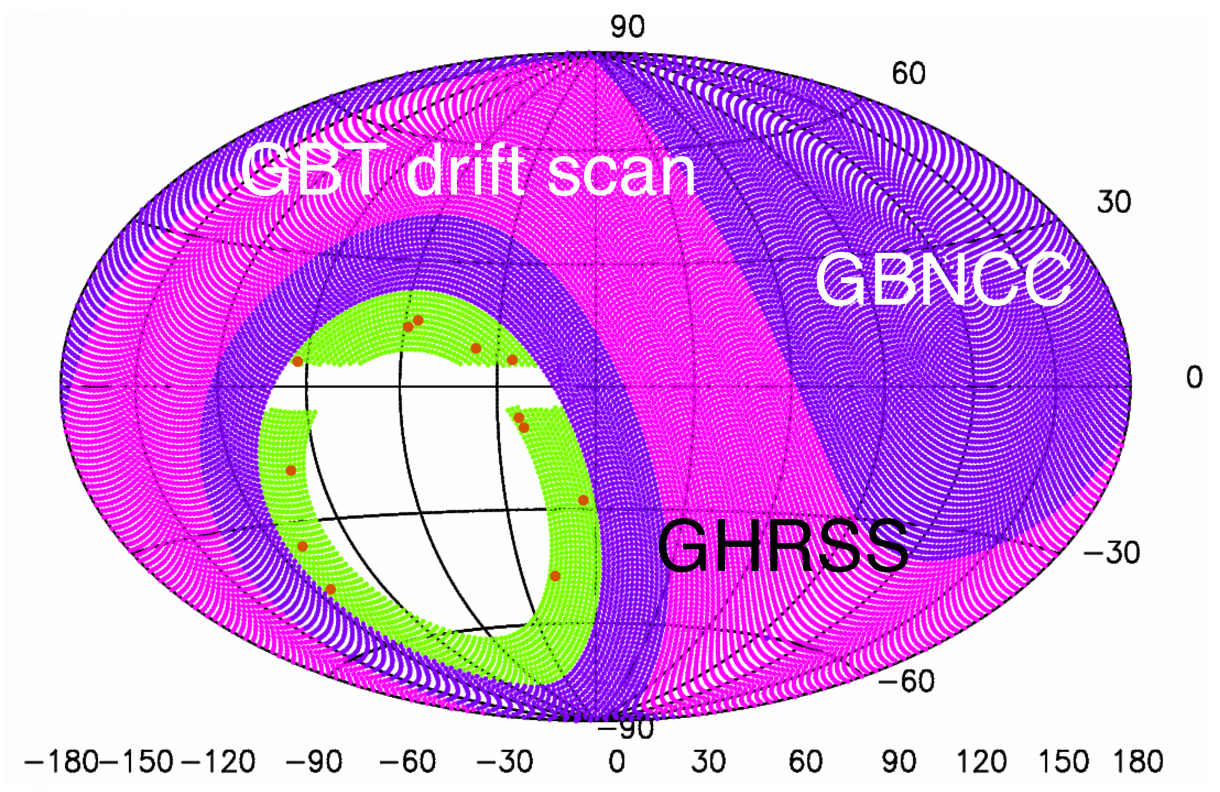
GMRT High Resolution Southern Sky (GHRSS) survey
An off-Galactic plane (|b| > 5°) survey at 322 MHz
Discovered 17 pulsars
Including:
1 millisecond pulsar (MSP)
2 mildly recycled pulsars
1 pulsar with γ-ray pulsation
Bhattacharyya et al. (2016)

Slide 19
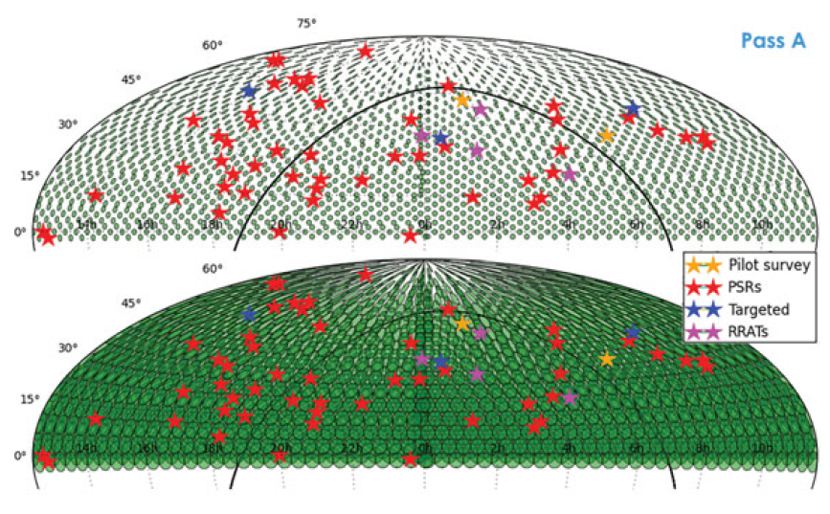
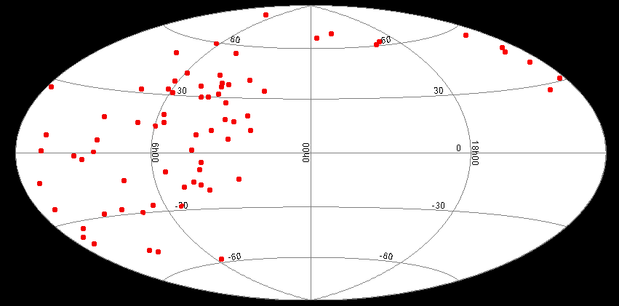
LOFAR Tied-Array All-Sky Survey (LOTAAS)
Entire Northern sky in three pass
Centre frequency: 135 MHz
72 confirmed discoveries
+
2 from pilot survey
+
4 targeted searches for pulsars
+
9 non-confirmed (yet) candidates
Interesting discoveries:
Slowest pulsar yet: 23.5 s spinning period
far beyond the conventional pulsar death line
Fastest field MSP: 1.414 ms spinning period
LOFAR Discoveries in Galactic Coordinate
Notes:
707 Hz binary millisecond pulsar that is now the fastest-spinning neutron star known in the Galactic field (I.e., outside of a globular cluster).
Slowest-spinning radio pulsar known. Far beyond the conventional pulsar death line

Slide 20
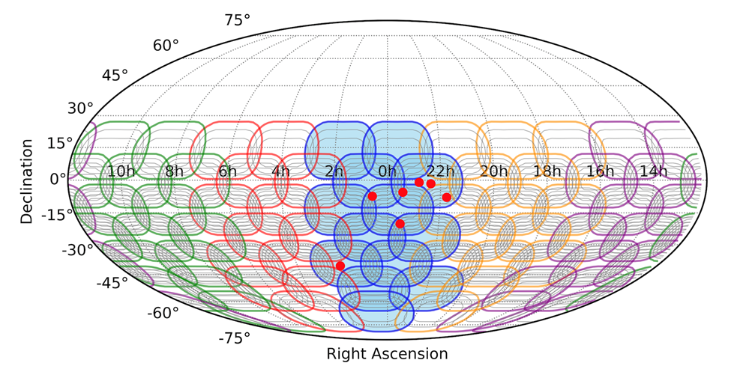
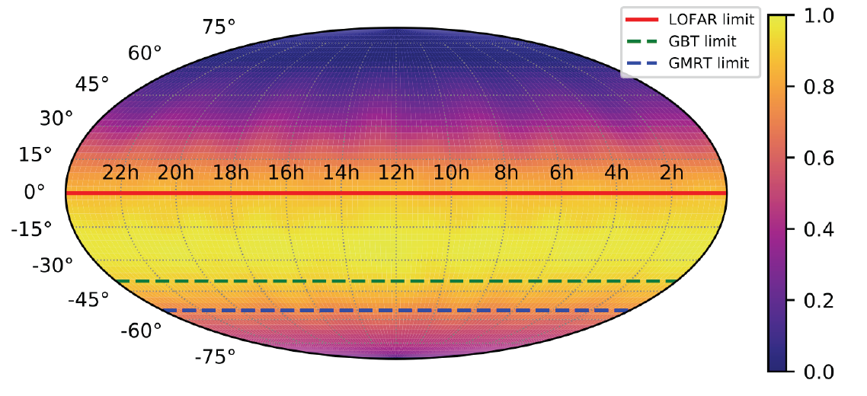
The Southern-sky MWA Rapid Two-metre
(SMART) pulsar survey
VCS pointings
(at 140-170 MHz)
20% observations have already been taken
Sensitivity map
(for 4800 sec)
Nick Swainston

Slide 21
Why Pulsars at < 300MHz
Surveys
Huge field-of-view
Higher flux density
Emission mechanism
Profile evolution
Polarimetry
Spectral indices (flattening, turnover, etc.)
Emission phenomena (nulling, sub-pulse drifting, etc.)
Interstellar medium
Precise dispersion measure
Precise rotation measure
Scattering

Slide 22
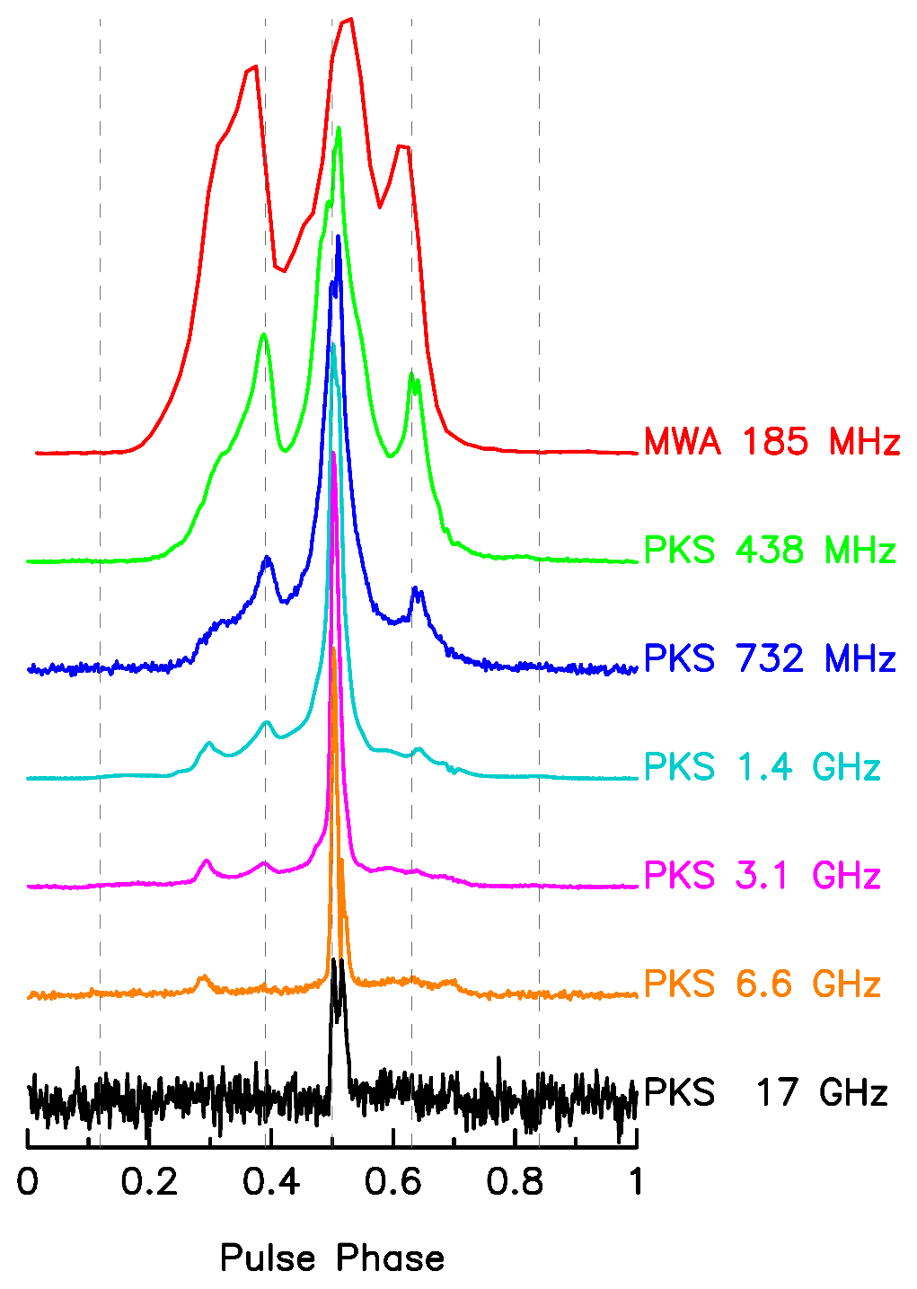
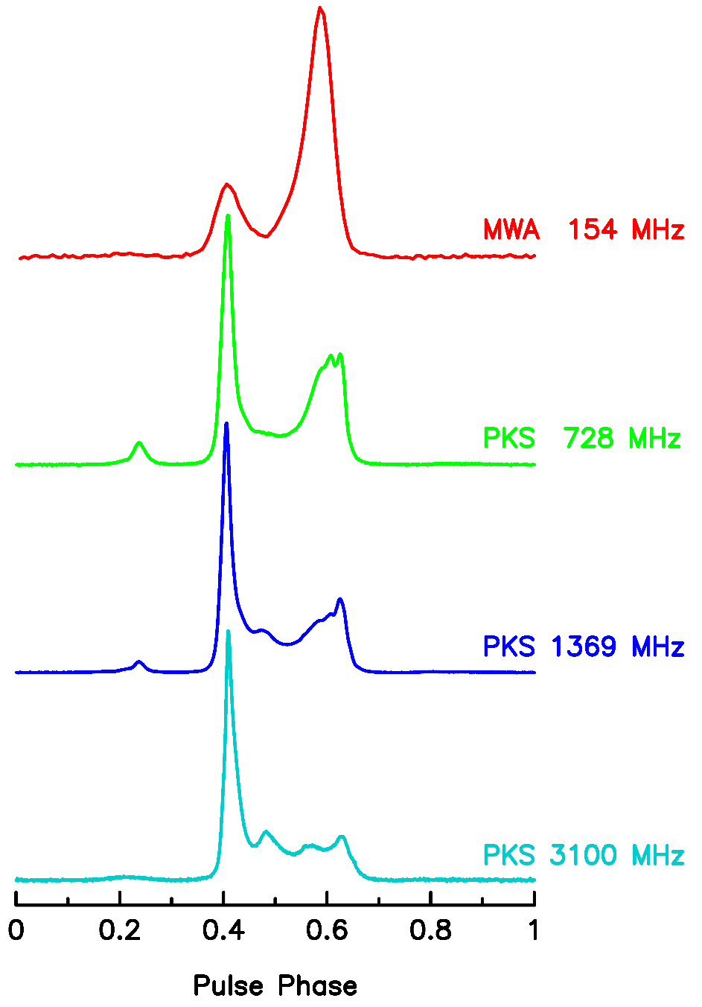
Profile evolution with frequency (MSPs)
MSP J0437-4715
MSP J2145-0750
MSP J2145-0750
Bhat et al. (2018)

Slide 23
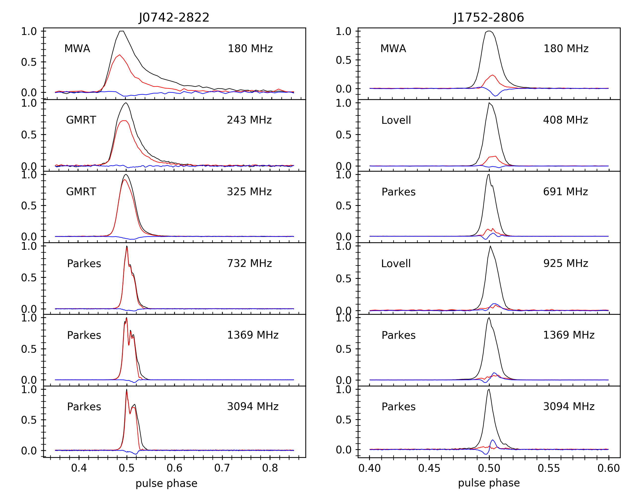
Polarimetric profiles evolution with frequency
Xue et al. submitted

Slide 24
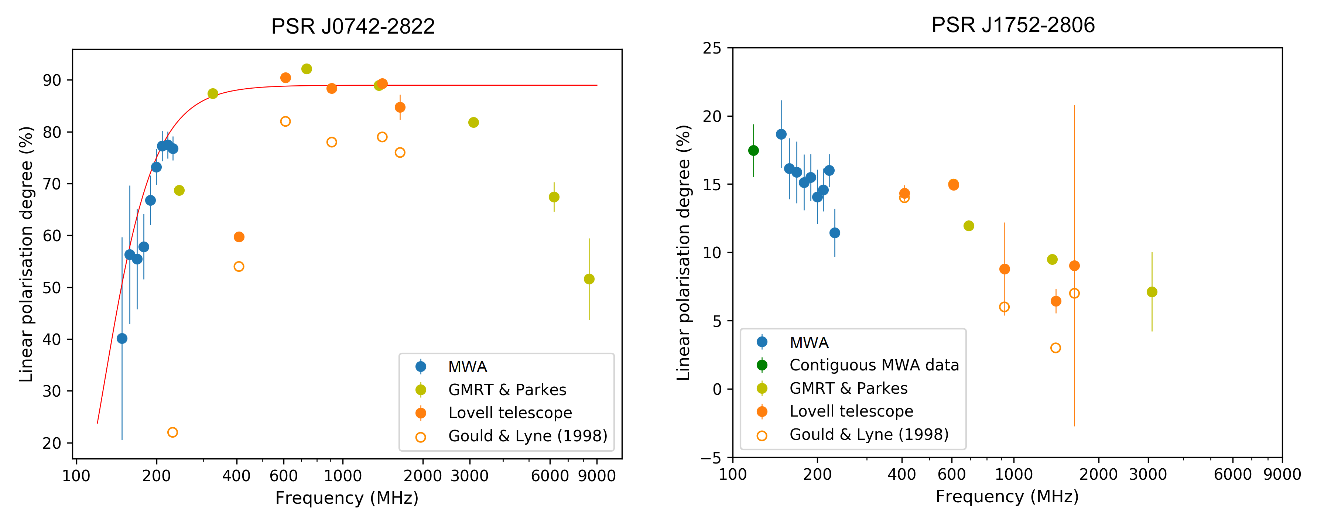
Fraction of linear polarisation as a function of frequency
Xue et al. submitted
Notes:
Origin of this depolarization? Probably not pulsar magnetosphere. We also don’t think it is caused by the ionosphere. Gum nebula.
We are starting on this.

Slide 25
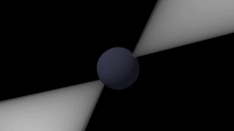
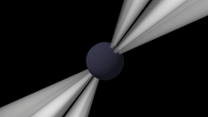
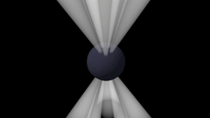
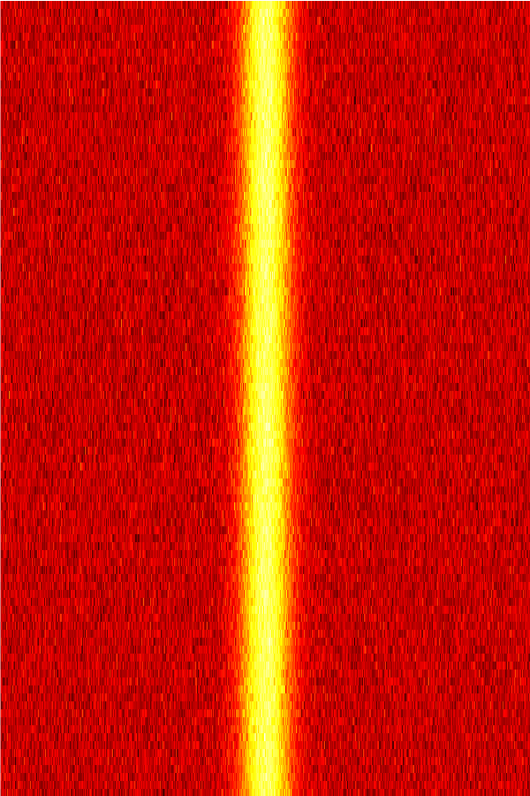
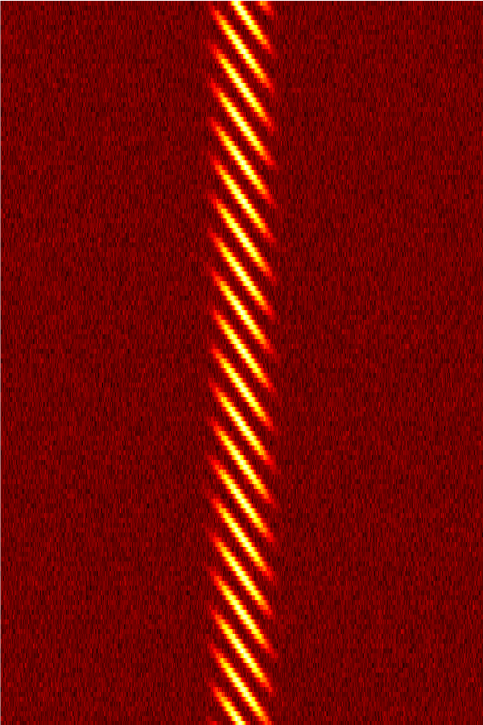
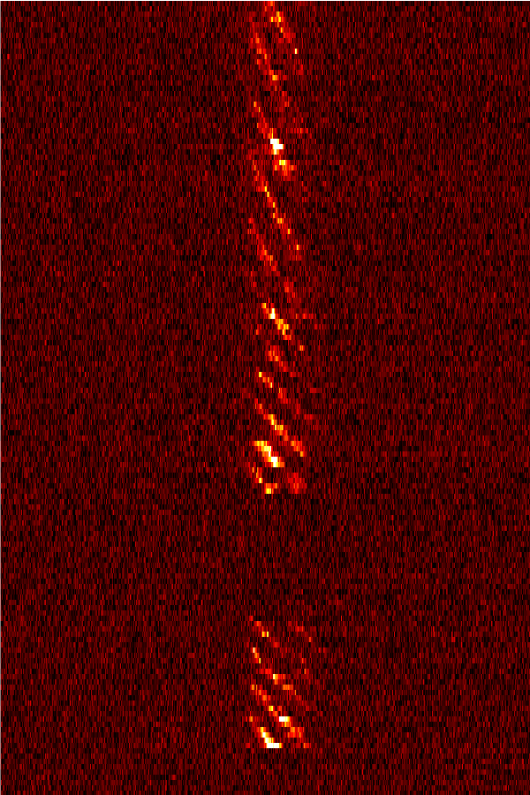
Sub-pulse Drifting in Pulsar Emission
“Lighthouse”
Simulation
“Carousel”
Simulation
Real data (MWA)
(PSR J0034-0721)
Time
Time
1 pulsar rotation
Credit: S. McSweeney

Slide 26
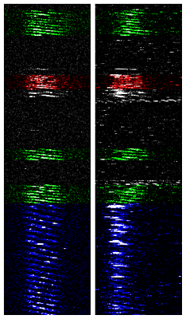
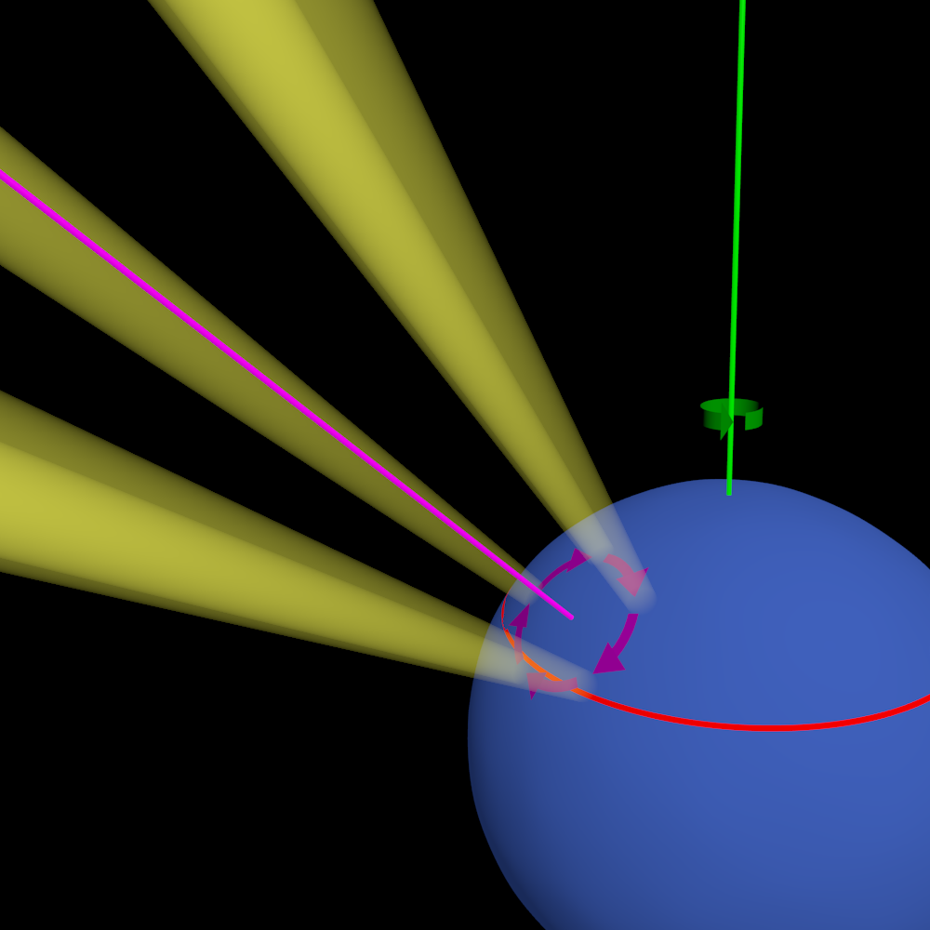
Modelling wide-band emission from PSR J0034-0721
MWA
(185 MHz)
GMRT
(610 MHz)
Simultaneously sampling different heights in the pulsar's magnetosphere
McSweeney et al. in prep.

Slide 27
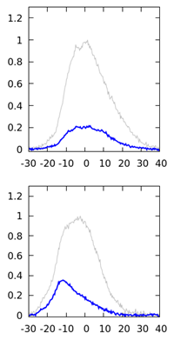
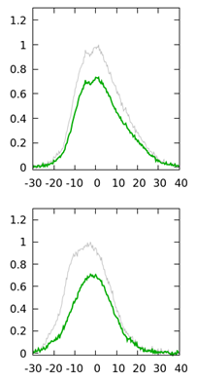
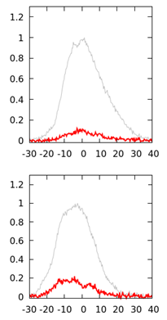
Modelling wide-band emission from PSR J0034-0721
MWA
(185 MHz)
GMRT
(610 MHz)
Mode A
Mode B
Mode C (*10)
MWA
(185 MHz)
GMRT
(610 MHz)
Simultaneously sampling different heights in the pulsar's magnetosphere
McSweeney et al. in prep.

Slide 28
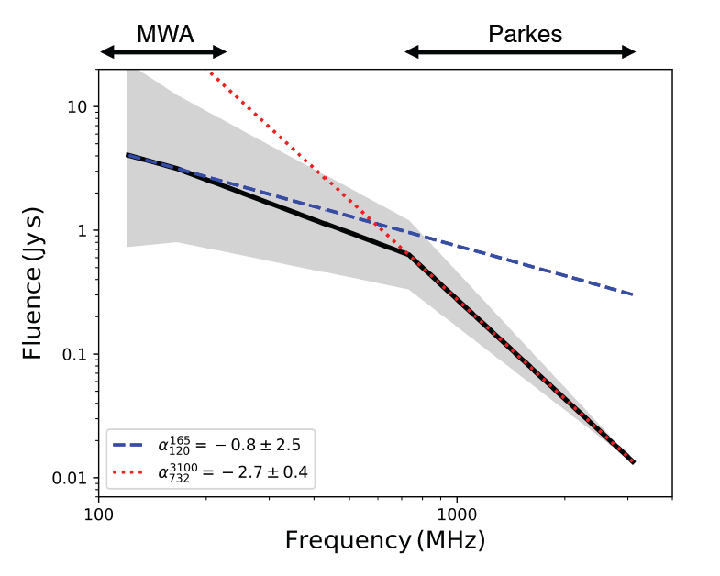
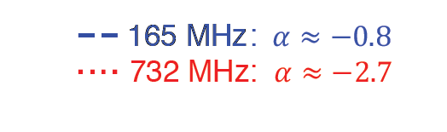
Flattening Spectrum of Crab Giant Pulses
Parkes
MWA
A Crab giant pulse observed simultaneously from
3.1 GHz to 120 MHz.
The giant pulse fluence spectrum is flattening at low frequencies.
Meyers et al. (2017)

Slide 29
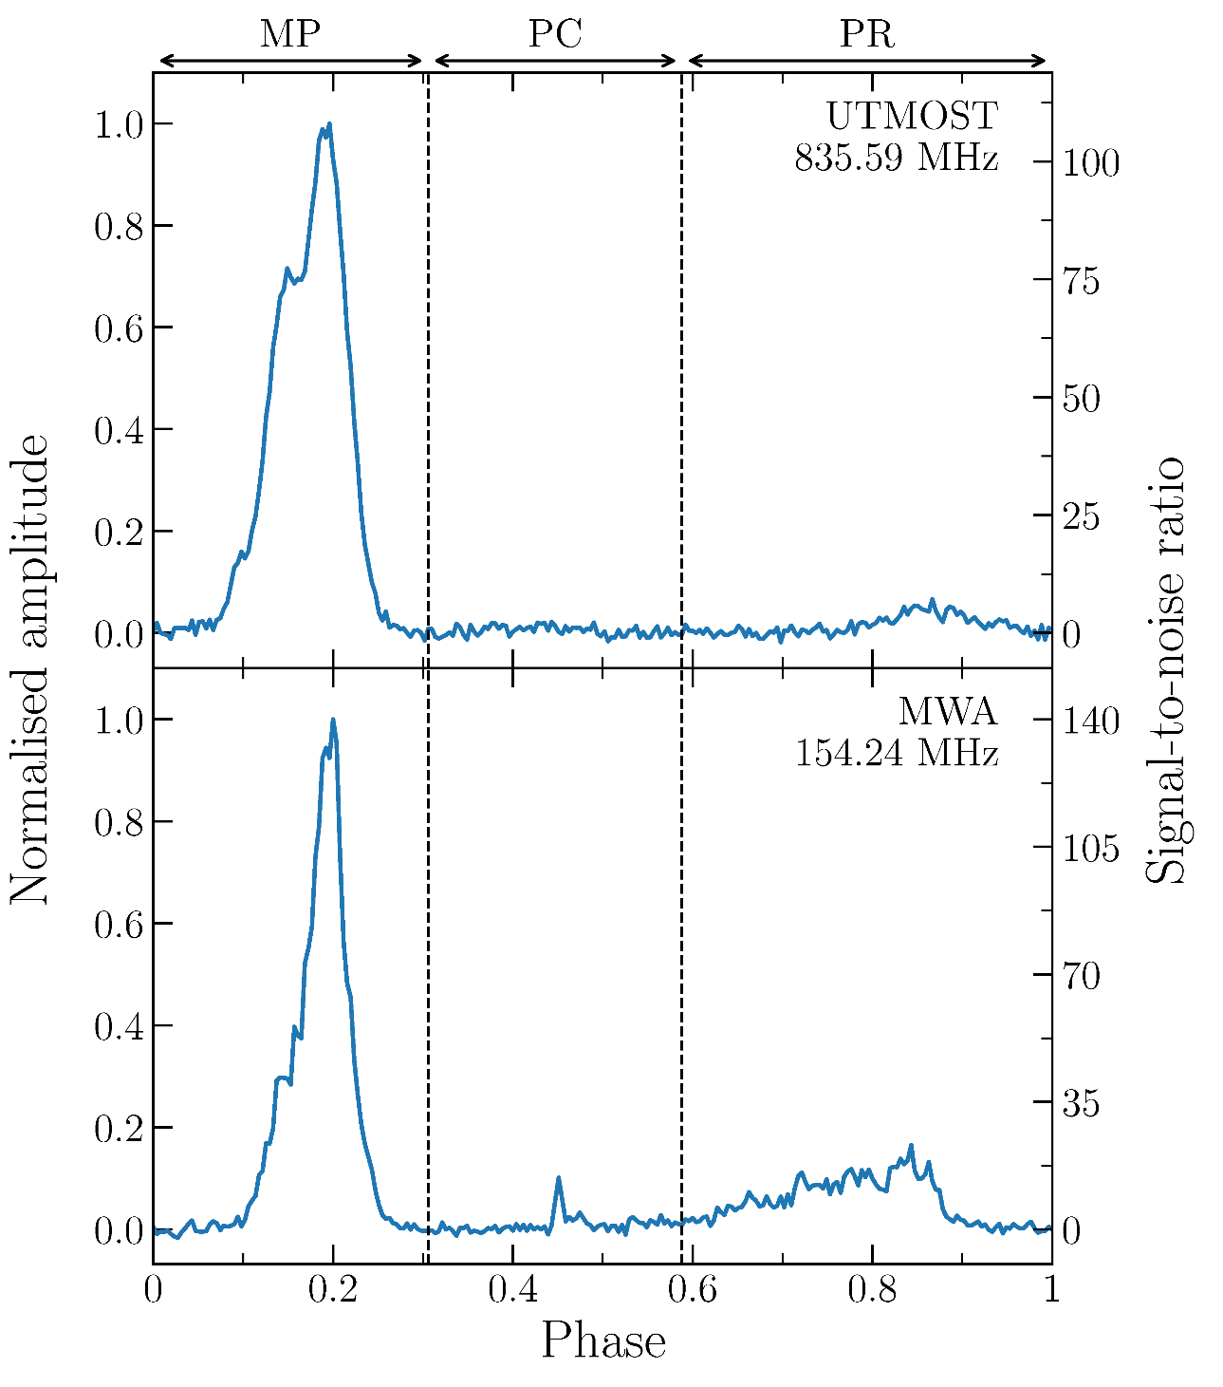
Steeper spectrum of intermittent pulsar J1107-5907
MP: main pulse
PC: postcursor
PR: precursor
Different spectral index per component：
α_MP = −1.8 ± 0.1
α_PR = −2.2 ± 0.1
Meyers et al. (2018)

Slide 30
Why Pulsars at < 300MHz
Surveys
Huge field-of-view
Higher flux density
Emission mechanism
Profile evolution
Polarimetry
Spectral indices (flattening, turnover, etc.)
Emission phenomena (nulling, sub-pulse drifting, etc.)
Interstellar medium
Precise dispersion measure
Precise rotation measure
Scattering

Slide 31
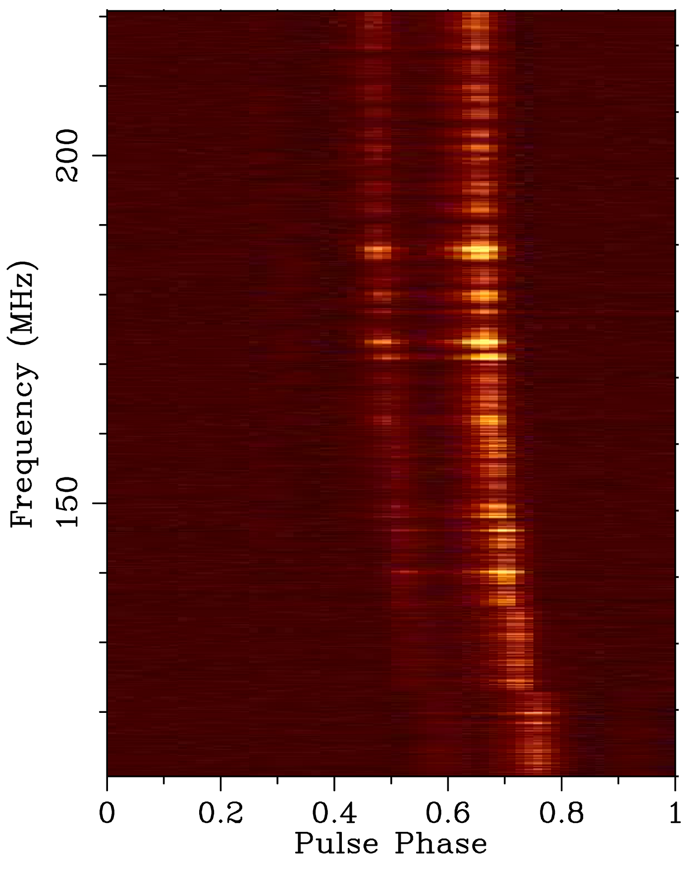
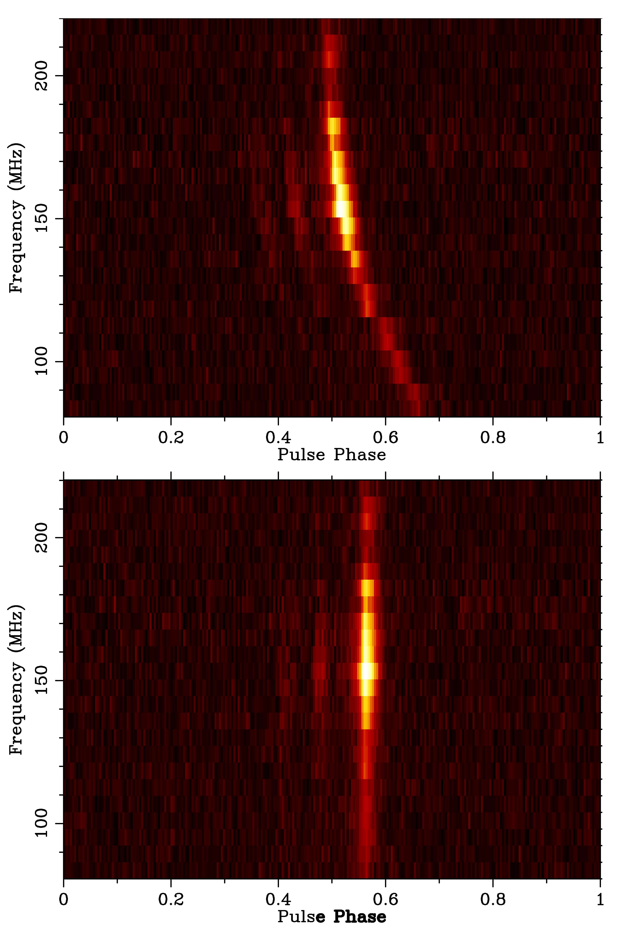
Precise Dispersion Measure
J2145-0750
MWA
110 - 220 MHz
MWA
80 - 220 MHz
MSP J2145-0750
MSP J2241-5236
Catalog DM:
11.41085 pc cm⁻³
Catalog DM:
8.998 pc cm⁻³
DM correction:
0.006 pc cm⁻³
DM correction:
0.000667 pc cm⁻³
Kaur et al. in prep.
Bhat et al. 2018

Slide 32
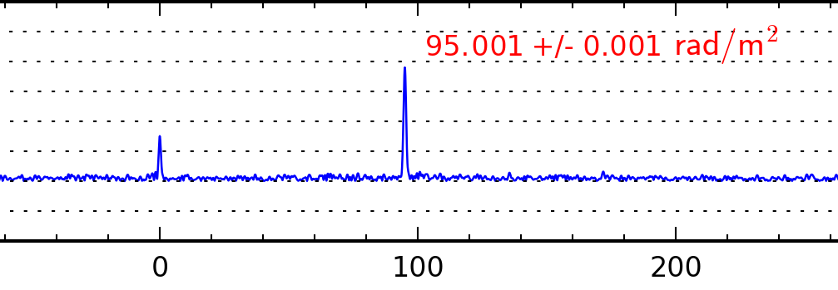
Precise Rotation Measure from MWA
Target pulsar : | J1752-2806 (Literature RM=96.0±0.2, Hamilton and Lyne 1987)
Centre Frequency | 154 MHz | 118 MHz
Observation ID (GPS time) | 1149612832 | 1117643248
Observed RM (radm⁻²) | 95.031±0.012 | 95.001±0.001
Ionosphere RM (radm⁻²) | -0.789±0.038 | -0.807±0.104
Interstellar RM (radm⁻²) | 95.820±0.040 | 95.808±0.104
RM Spectrum
RM (rad m⁻²)
Xue et al. submitted

Slide 33
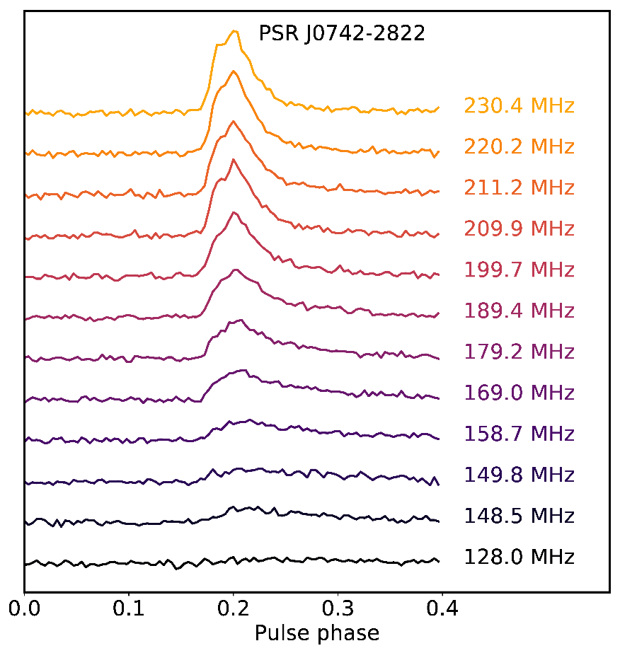
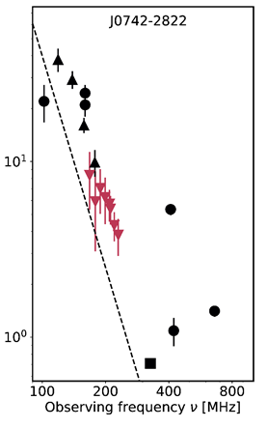
Pulsar scattering across the MWA-band
▼ This work
-- τ ∝ ν⁻⁴
Scattering delay (ms)
Kirsten et al. submitted

Slide 34
Summary
Pulsars at low radio frequency :
Brighter if having a steep spectrum
Emit from different region
Affected more by the interstellar medium
(pros & cons)
Survey efficiency

Slide 35
Thanks!

Slide 36
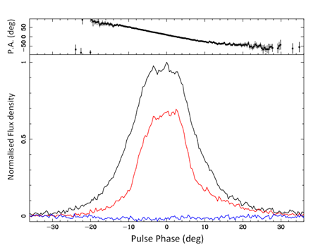
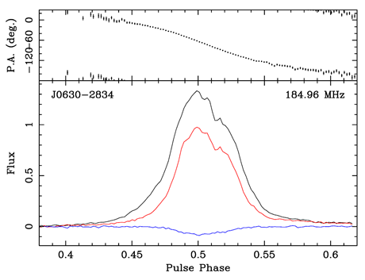
Pulsar polarimetry
J0630-2834 at 690 MHz Parkes
J0630-2834 at 185 MHz MWA
Polarisation profiles at low frequency for a large sample of southern pulsars
-> Pulsar emission physics (e.g. the degree of polarisation with frequency)
-> Beam geometries (e.g. RVM fits of the P.A. curve)
Notes:
30min obs

